Slide 1
Young People’s World: Making Your Future
Energy, Climate & Human Health
James Hansen
November 2018
Sustainable Development
Lehigh University Course
Notes:
Let’s talk about global energy consumption, and the effect that it has on climate and human health.
Energy is useful, but it causes problems. Young people need to turn the problems into opportunities. But to do that, you need to understand the situation.
I’m going to give you a personal perspective, telling you how I came to know what I know. It’s probably the best I can do at the moment. I will try to provide a more comprehensive view in Sophie’s Planet, the book I am writing now, which I should finish this winter.

Slide 2
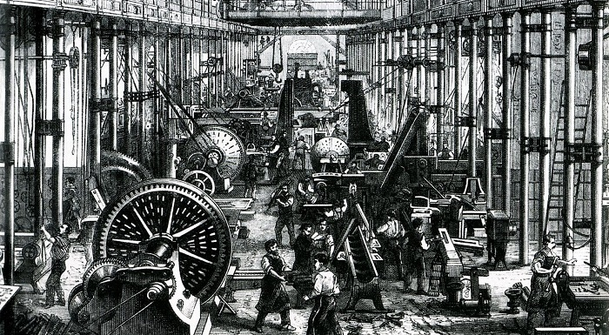
Notes:
Fossil fuels are remarkable. They powered the industrial revolution

Slide 3
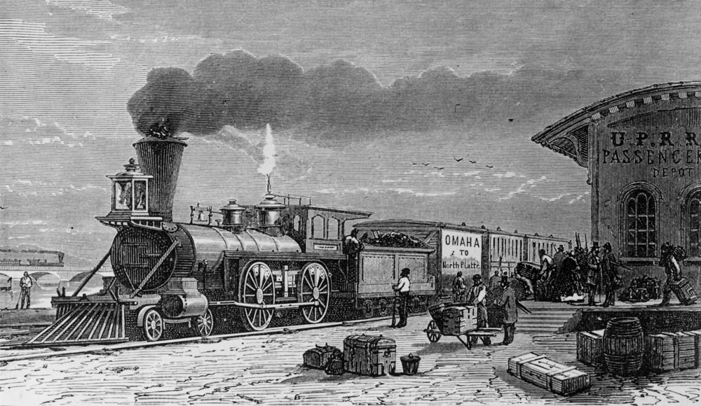
Notes:
Including transportation. Omaha to North Platte. Omaha is near my home town in western Iowa.

Slide 4
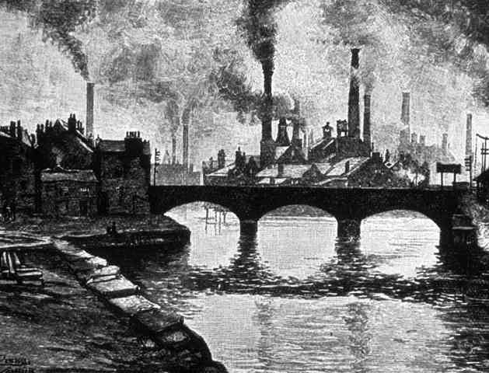

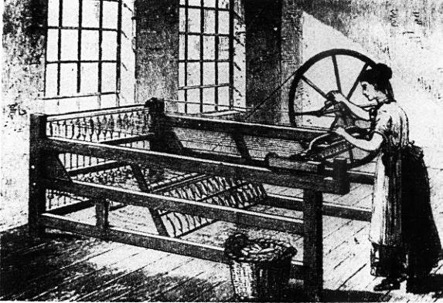

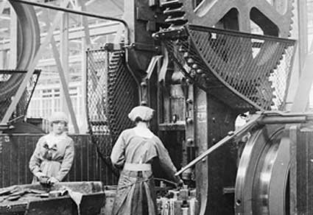

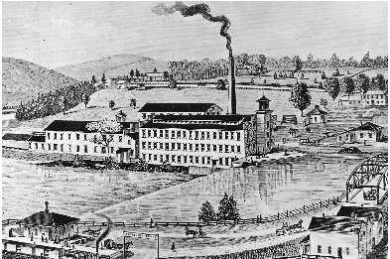
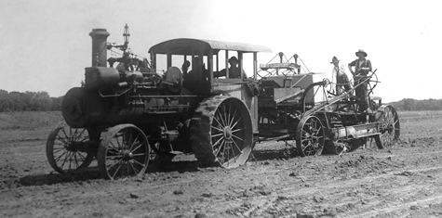
The
Industrial
Revolution
Notes:
Some scholars say that fossil fuels were the real basis for eliminating slavery, although perhaps we all became slaves in another way.

Slide 5

Notes:
But living standards were raised. People love and use the power that fossil fuels bring.
One liter of petrol contains the work equivalent of 100 hours labor by a healthy adult.

Slide 6

Notes:
Now, what do I know that would cause me, a soft-spoken Midwestern scientist, to get arrested protesting in front of the White House?

Slide 7
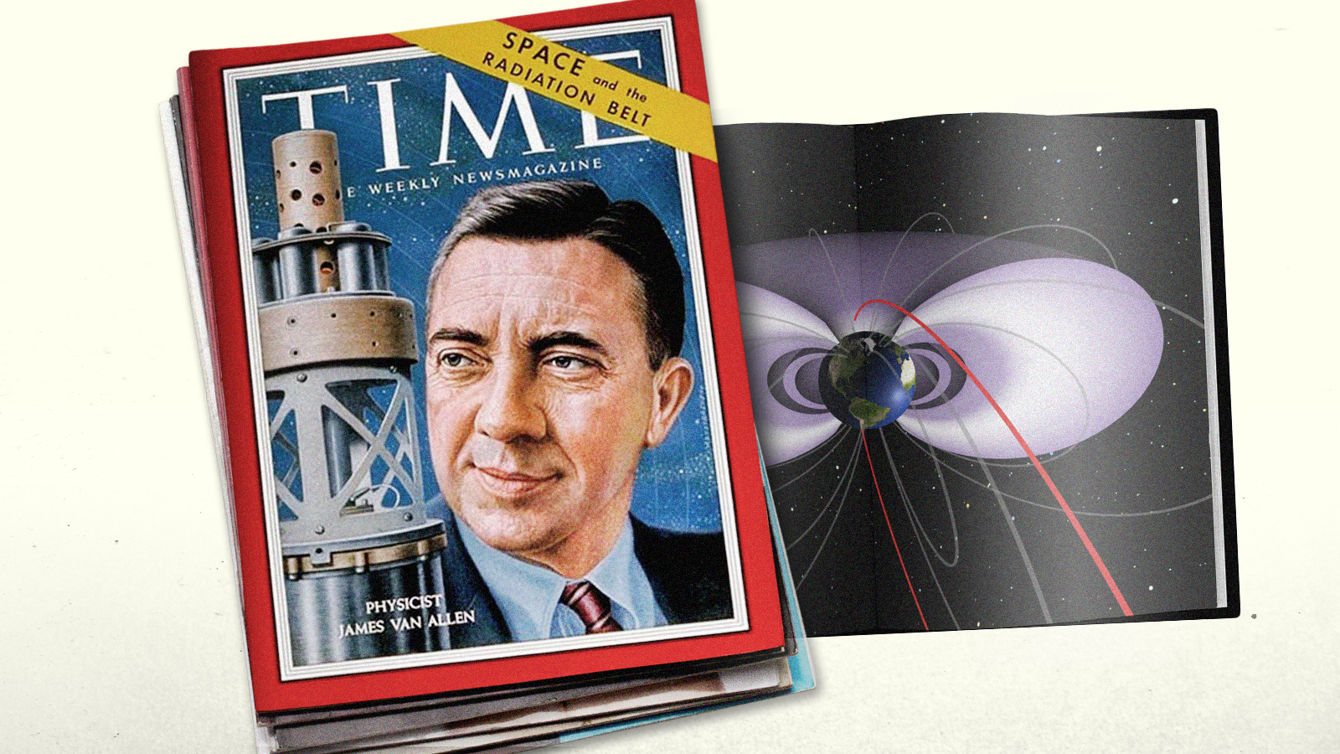
Notes:
I was lucky to grow up at a time when it was not difficult for the child of a tenant farmer to make his way to a state university.
I was especially lucky to study under Prof. James Van Allen, who built instruments for the first U.S. satellites at the University of Iowa.
Prof. Van Allen told me about observations of Venus. Venus was emitting intense microwave radiation. Did it mean that Venus had an ionosphere … or was Venus extremely hot?
The right answer, confirmed by Soviet Venera spacecraft, was that the surface was very hot, 900°F … kept hot by a thick carbon dioxide atmosphere.

Slide 8
Goldilocks Planets
Greenhouse warmings are about 5°C, 33°C and 500°C
on Mars, Earth and Venus, respectively.
Notes:
Mars, Earth and Venus confirm the greenhouse effect.
The greenhouse effect is the excess temperature relative to what is expected, given the amount of sunlight each planet absorbs.
As greenhouse gas amount increases, excess warming increases. Earth is not too cold or too hot. It’s just right for life.

Slide 9

Notes:
I was fortunate to join NASA and successfully propose an experiment to fly to Venus.
Our instrument, a telescope one and a half inches in diameter, took this image of the Veil of Venus.
This smog enveloping Venus turned out to be sulfuric acid – not a very romantic planet.
While our instrument was being built, I became involved in calculations of the greenhouse effect here on Earth, because we realized that our atmospheric composition was changing.

Slide 10
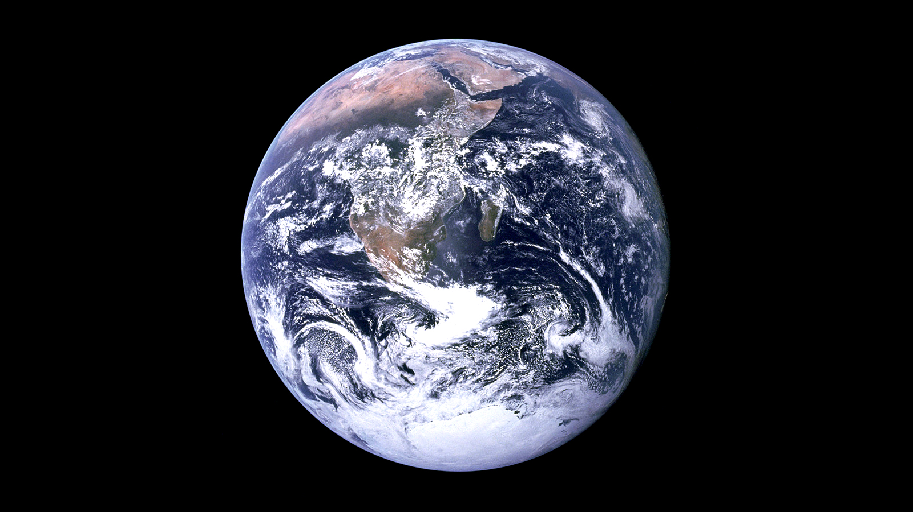
Notes:
I resigned as principal investigator on our Venus experiment … because changes on our own planet are more interesting and important. They will affect all humanity.
I worked on using observations of weather stations to develop a history of Earth’s temperature and with a team of colleagues to develop a mathematical model of Earth’s climate.
Omit: The greenhouse effect had been understood for a century. Irish physicist John Tyndall, in the 1850s, made laboratory measurements of infrared radiation, which is heat. He showed that gases such as CO₂ absorb heat, thus acting like a blanket, warming Earth's surface.

Slide 11
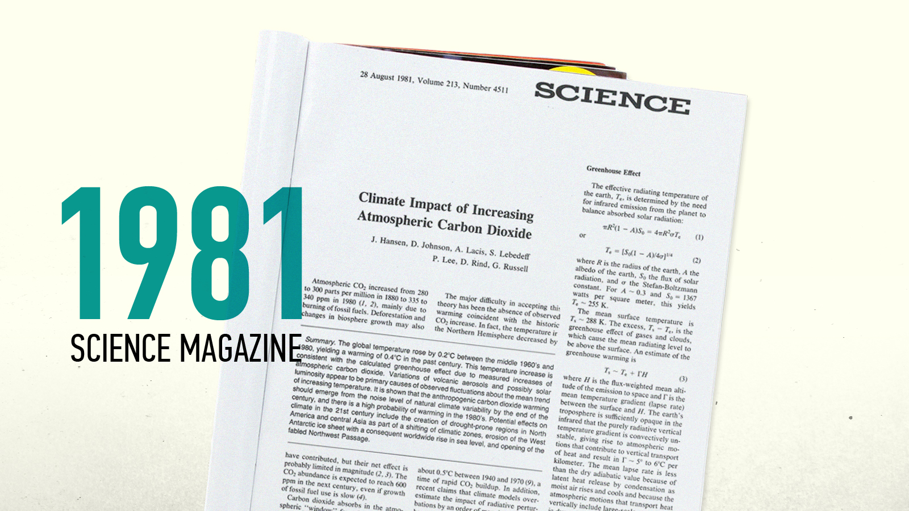
Notes:
After 5 years, in 1981 we published an article in Science Magazine concluding that Earth had warmed 0.4°C in the prior 100 years, that observed warming matched calculated warming due to increasing CO₂, that Earth would warm more in the 1980s, and that warming would exceed natural variability before the end of the century.
We also said that the 21st century would see shifting climate zones, creation of drought prone regions in North America and Asia, erosion of ice sheets, rising sea levels, and opening of the fabled Northwest passage.
All of these have since occurred.

Slide 12
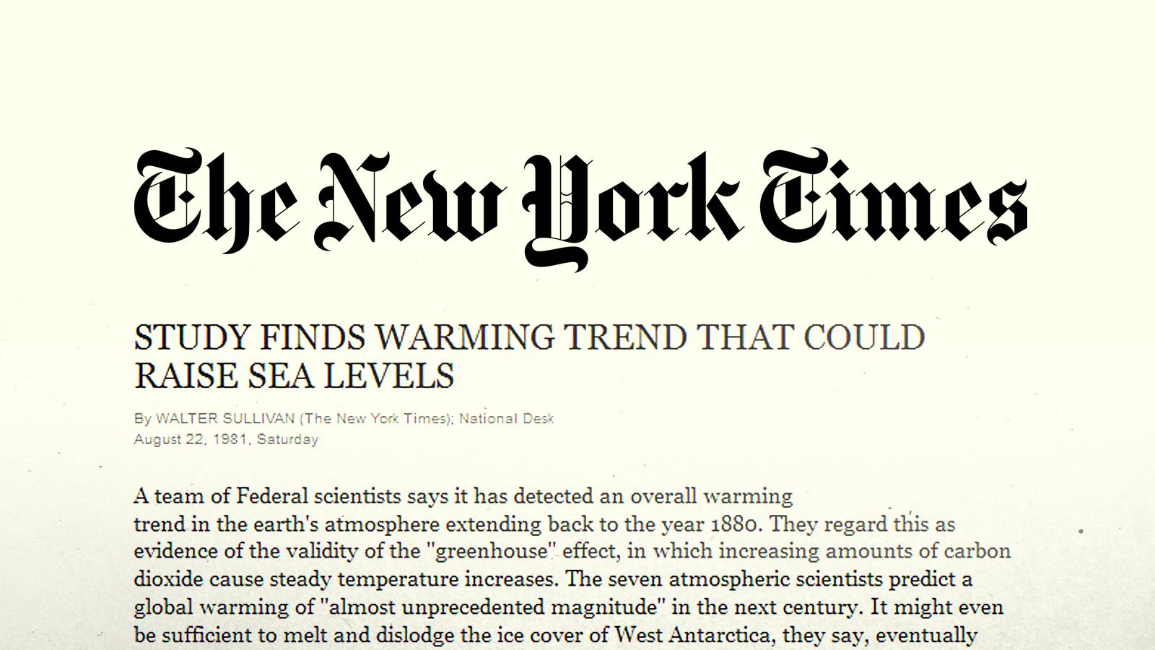
Notes:
That paper was reported on the front page of the New York Times and led to me testifying to Congress in the 1980s.

Slide 13

Notes:
… testimony in which I emphasized that global warming increases both extremes of the hydrologic cycle, heat waves and droughts, on one hand, directly from the warming,
but also, because a warmer atmosphere holds more water vapor, with its latent energy, rainfall can occur in more extreme events, there are stronger storms, and greater flooding.

Slide 14
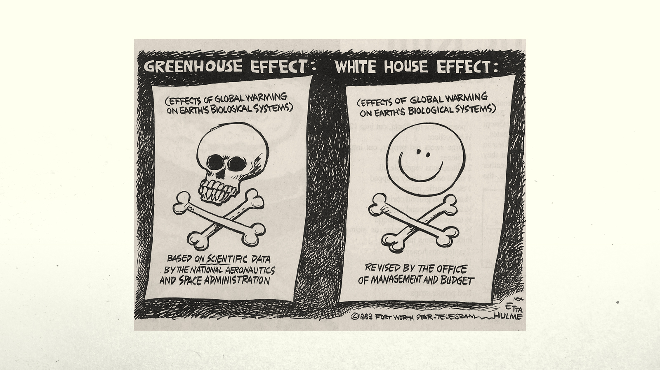
[S#10] [S#10]
Notes:
The Bush Administration did not like my testimony, and the Office of Management and Budget inserted some changes in my testimony that made the effects of climate change seem more innocuous.
After I complained publicly about these alterations, global warming hoopla became time consuming and distracted me from doing science.

Slide 15
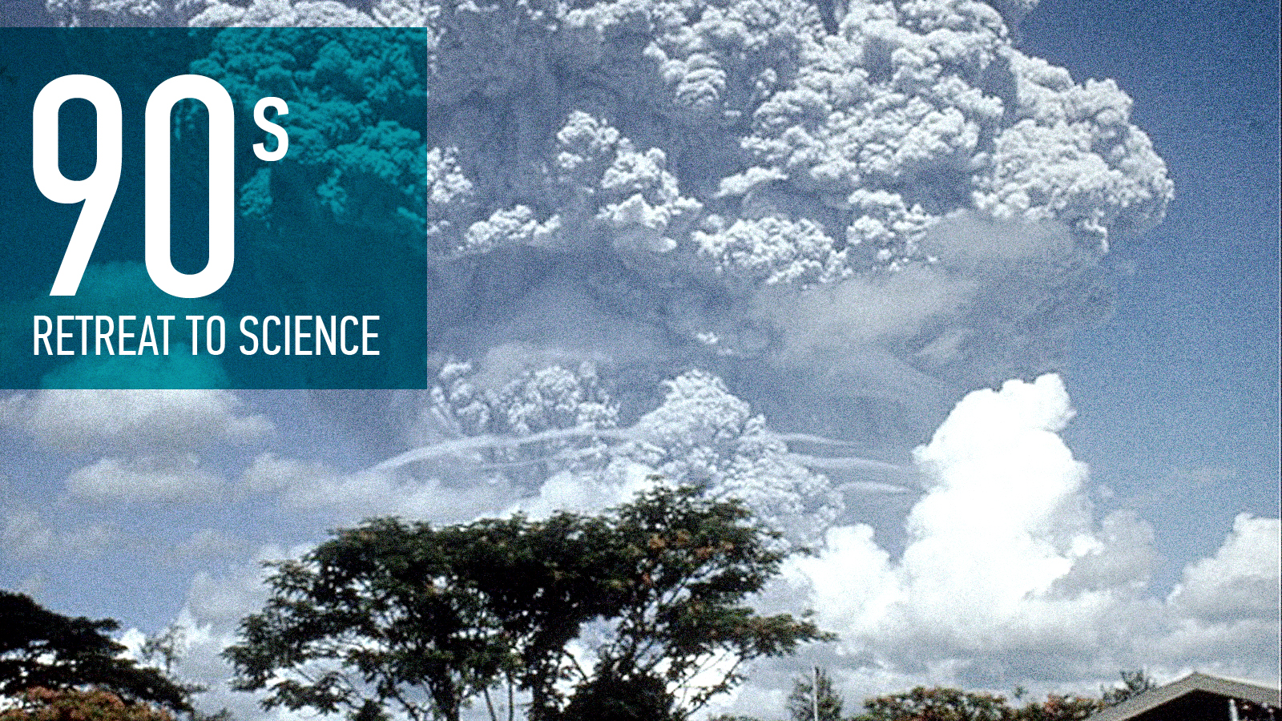
Notes:
So I decided to go back to strictly doing science and leave communication to scientists who were good at media communication and even enjoyed it.

Slide 16
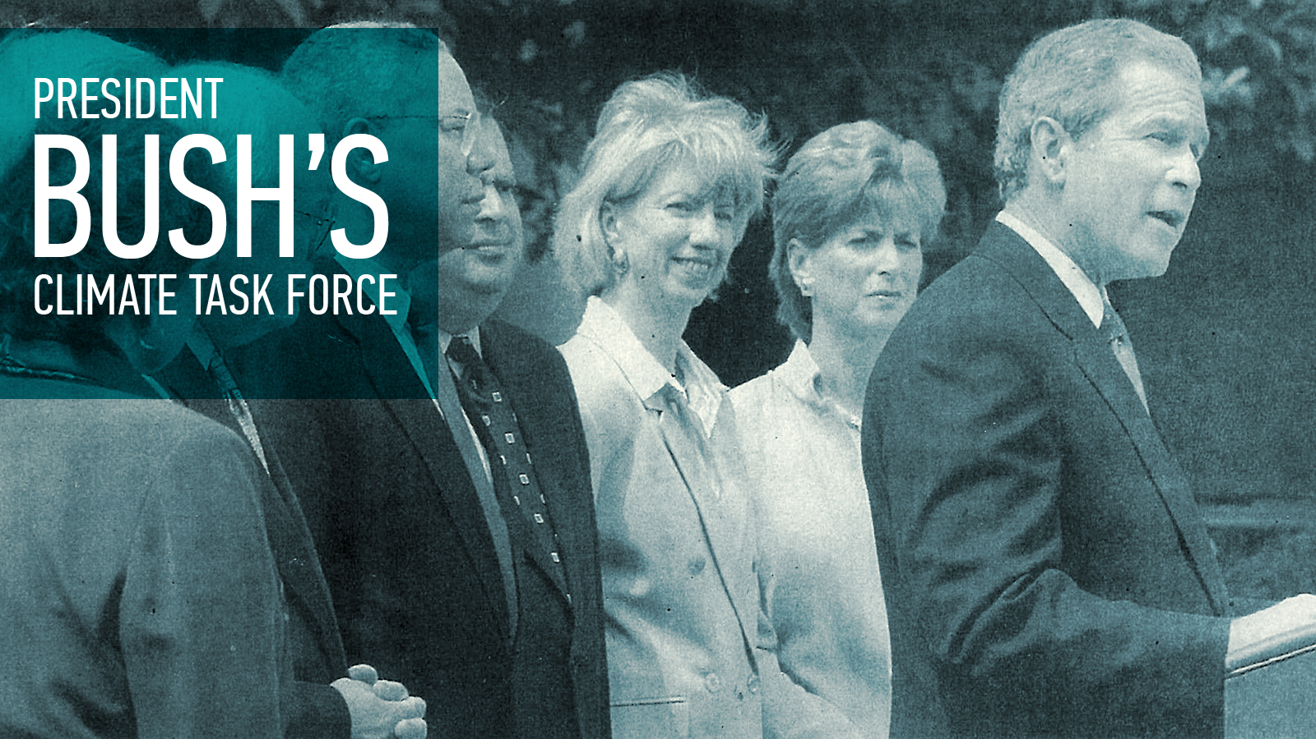
Photo Credit: Stephen Crowley/The New York Times
Notes:
However, by 15 years later evidence of global warming was much stronger - most of the things mentioned in our 1981 paper were established facts.
I was privileged to speak twice to the President's Energy Task Force: Vice President Cheney and 6 cabinet members, but U.S. energy policy continued to focus on fossil fuels.
At the same time, my view of the safe level of atmospheric CO2 began to diverge sharply from that of the prominent climate science communicators.

Slide 17

Notes:
And by then we had two grandchildren. I decided that I did not want them, in the future, to say "Opa understood what was happening, but he didn't make it clear."

Slide 18
Dangerous Anthropogenic Interference
A Discussion of Humanity’s Faustian Climate Bargain and the Payments Coming Due
James E. Hansen Distinguished Lecture
Van Allen Hall, University of Iowa
Notes:
I decided to make a public statement criticizing lack of an appropriate energy policy.
After I encountered resistance to giving a talk in Washington, Professor Van Allen kindly arranged for a lecture at the University of Iowa in October 2004.

Slide 19
Is There Still Time to Avoid
‘Dangerous Anthropogenic Interference’ with Global Climate?
A Tribute to Charles David Keeling
James Hansen presentation 6 December 2005
American Geophysical Union, San Francisco
Notes:
14 months later I gave a similar talk at the 2005 American Geophysical Union meeting.

Slide 20
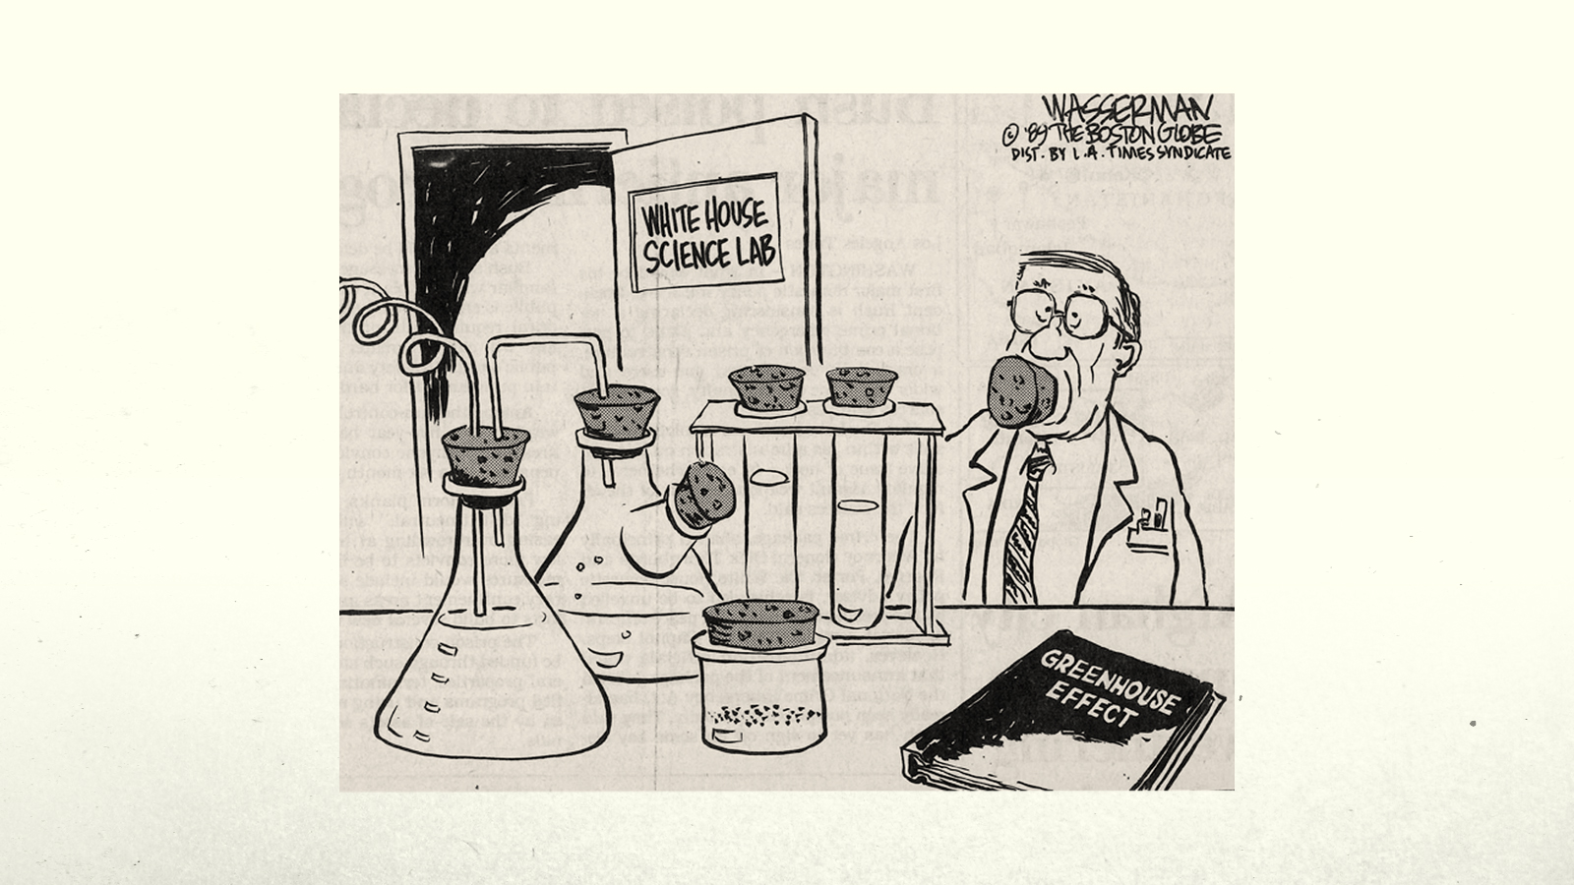
Notes:
That talk led to several calls from the White House to NASA Headquarters.
I was told that I could give no more talks, or speak with the media, without explicit prior approval by NASA Headquarters.

Slide 21
Notes:
After I informed the New York Times about these restrictions, NASA was forced to end the censorship. But there were consequences.

Slide 22


Notes:
I had used the first line of the NASA Mission Statement, to understand and protect the home planet, to justify my talks.
Soon this line of the mission statement was deleted, never to appear again.

Slide 23

Photo Credits: Greenpeace, Michelle Muus, David Schmoll
Notes:
In the next few years, I was drawn more-and-more into communicating the urgency to change energy policies, while still researching the physics of climate change.
Let me describe two of the most important pieces of that physics.

Slide 24
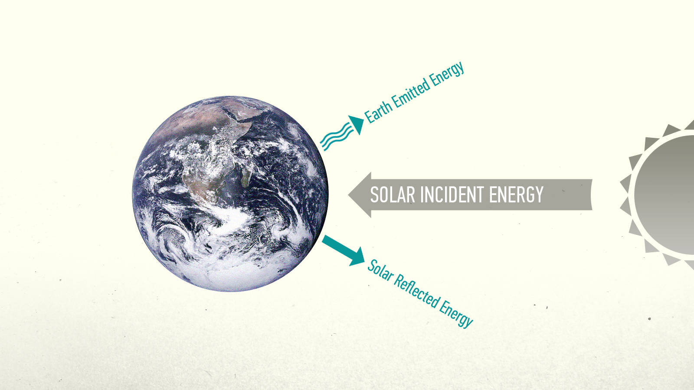
Notes:
Adding CO₂ to the air is like throwing another blanket on the bed.
It reduces Earth's heat radiation to space, so there is an energy imbalance, more energy is coming in than going out – until Earth warms up enough to again radiate to space as much energy as it absorbs from the sun.
As long as more energy is coming in than going out, more global warming is in the pipeline … it will occur even without any more greenhouse gases.

Slide 25
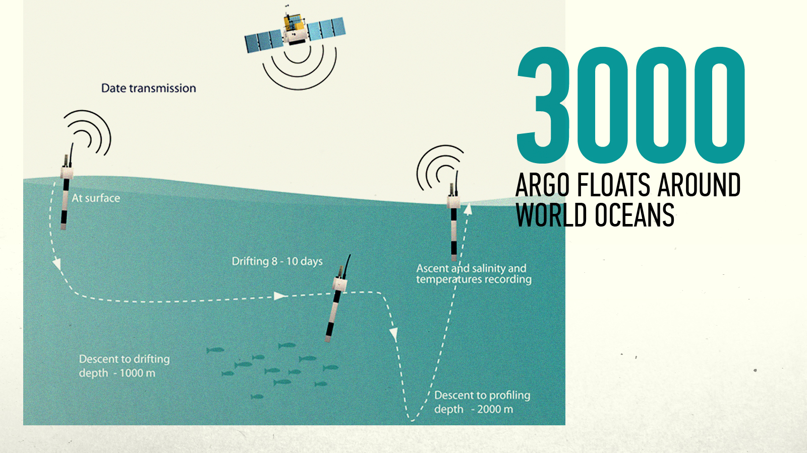
Notes:
We can now measure Earth's energy imbalance by measuring the heat content in Earth's heat reservoirs.
The biggest reservoir, the ocean, was the least well measured until more than 3000 Argo floats were distributed around the world's oceans.

Slide 26
WHERE EXCESS ENERGY IS GOING
0.6
During Solar Minimum Earth gained energy at a rate nearly 20 times greater than humanity’s energy use.
0.5
0.4
0.3
W/m² of Globe
0.2
0.1
0
Upper Ocean
(200 m)
Deep Southern
Ocean
Abyssal
Ocean
Ice Melt
Land (Ground)
Warming
Notes:
These floats reveal that the upper ocean is gaining heat at a substantial rate, and the deep ocean at a smaller rate.
Energy is also going into net melting of ice all around the planet. And the continents, to depths of tens of meters, are getting warmer.
The total energy imbalance is now about three-quarters of a watt per square meter.

Slide 27
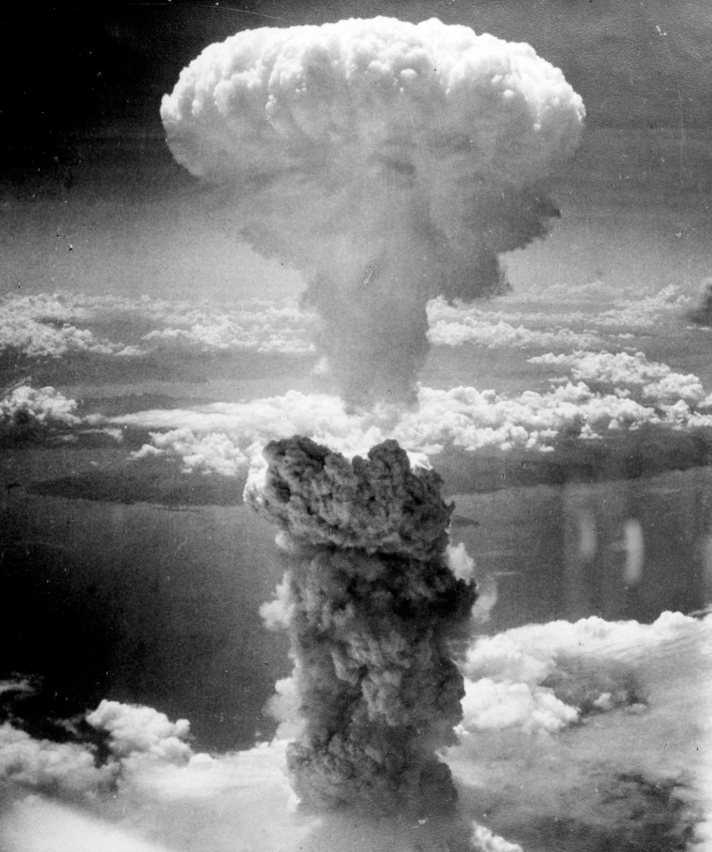
Notes:
That's about 20 times greater than the rate of energy use by all of humanity.
It's equivalent to exploding about 500,000 Hiroshima atomic bombs per day 365 days per year. That's how much extra energy Earth is gaining each day.
This imbalance means there is more warming in the pipeline, without additional CO₂. It also means, if we want to stabilize today’s climate we must reduce CO₂ from 410 ppm (parts per million) to at most 350 ppm. That’s the change needed to restore energy balance.

Slide 28
Notes:
Climate change deniers argue that the sun is the main cause of climate change.
But the measured energy imbalance occurred during the deepest solar minimum in the record, when solar energy reaching Earth was least. Yet more energy was coming in than going out.
So the effect of the Sun's variability is overwhelmed by the increasing greenhouse effect due to fossil fuel burning.

Slide 29
2
GLOBAL TEMPERATURE CHANGE (°C)
Holocene
0
Temperature Anomaly (°C))
-2
-4
Ice Age
800
700
600
500
400
300
200
100
0
CO₂ CONCENTRATION (PPM)
300
250
CO₂ (ppm)
200
800
700
600
500
400
300
200
100
0
50
SEA LEVEL (METERS)
0
Sea Level (m)
-50
-100
800
700
600
500
400
300
200
100
0
) Time (Thousands of Years Before Present)
Notes:
Earth's history contains remarkable information on climate change. Global temperature, atmospheric CO₂, and sea level over 800,000 years can be derived from ocean cores and Antarctic ice cores – from ocean sediments and from snowflakes that piled up year-after-year forming a 3-kilometer thick ice sheet. Sea level is a measure of ice sheet size – when the ice sheets melt, sea level rises.
Climate change on such long time scale is instigated by oscillations of Earth’s orbit and the tilt of Earth’s spin axis, which alter the seasonal and geographical distribution of sunlight on Earth. These orbital forcings are weak and slow, changing on time scales from 20,000 to 100,000 years.
Climate changes on these long time scales are very large. The large magnitude is due almost entirely to two powerful amplifying feedbacks: ice sheets and CO₂. As Earth warms, ice melts and exposes darker ground that absorbs more sunlight. As the ocean warms it releases CO₂ – like a warm Pepsi.

Slide 30
Atmospheric CO₂ amount (right scale) during past 800,000 years.
Global temperature change is approximately half of the Antarctic
temperature change (left scale).
Source: Ice Melt, Sea Level Rise and Superstorms, Hansen et al., Atmos. Chem. Phys., 16, 1-52, 2016.
Notes:
CO₂ changes more slowly than ice sheets, so it is the control knob on global temperature, as you can see from this remarkable comparison of atmospheric CO₂ and Antarctic temperature
The same amplifying feedbacks must occur today. Physics does not change. As Earth warms, ice sheets will melt. CO₂, and its companions methane and nitrous oxide, will be released by the warming ocean, melting tundra, and wetlands.
We can't say exactly how fast these amplifying feedbacks will occur, but they will occur.

Slide 31
Note that the time scale for the past century has been expanded.
Paleo global surface temperature change is from ocean core data of Zachos et al. (Nature 451, 279-283, 2008) via equations of Hansen et al. (Phil. Trans. Roy. Soc. A, 371, 20120294, 2013).
Notes:
Let’s tack modern data onto the paleo record. CO₂ is shooting off scale. Temperature is also rising, but it has not caught up to the CO₂. That takes time. Why?
First, the ocean has great thermal inertia. It takes 100 years for the ocean surface temperature to reach two-thirds of its equilibrium response.
Second, there are the slow feedbacks. Ice sheets do not melt overnight. The paleoclimate record shows sea level lagging temperature by a few centuries. Does that mean that coastal cities are safe for several centuries? No, because human-caused change in greenhouse gases is much faster than any change in Earth’s history.
In our paper Ice Melt, Sea Level Rise and Superstorms we estimate that multi-meter sea level rise can occur in 50 to 150 years, if CO₂ continues to increase rapidly.

Slide 32
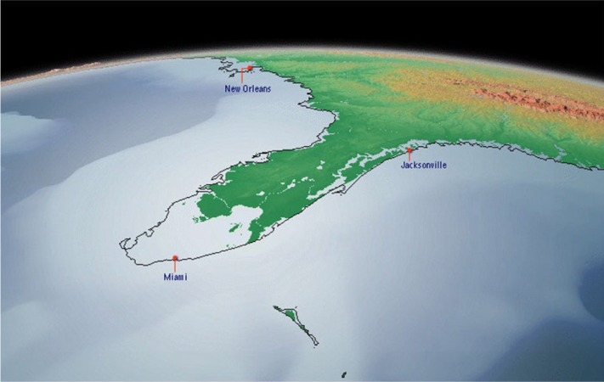
5 Meters (18 Feet) Sea Level Rise
Notes:
Sea level rise does not need to reach several meters before the economic impact becomes intolerable and the world likely becomes ungovernable.

Slide 33
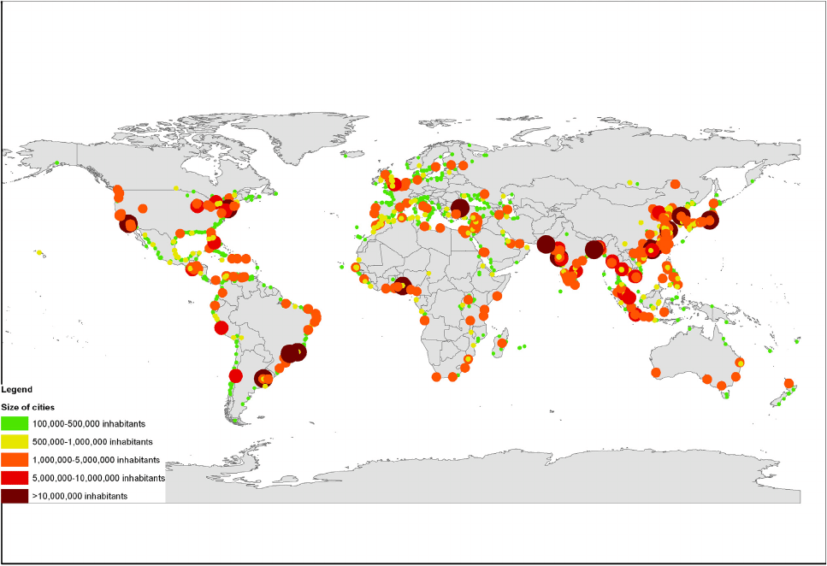
More than half of the world’s largest cities are on the coastline.
Notes:
Cities become dysfunctional long before they are totally under water.
These are all of the world’s largest cities. More than half are on coastlines.

Slide 34
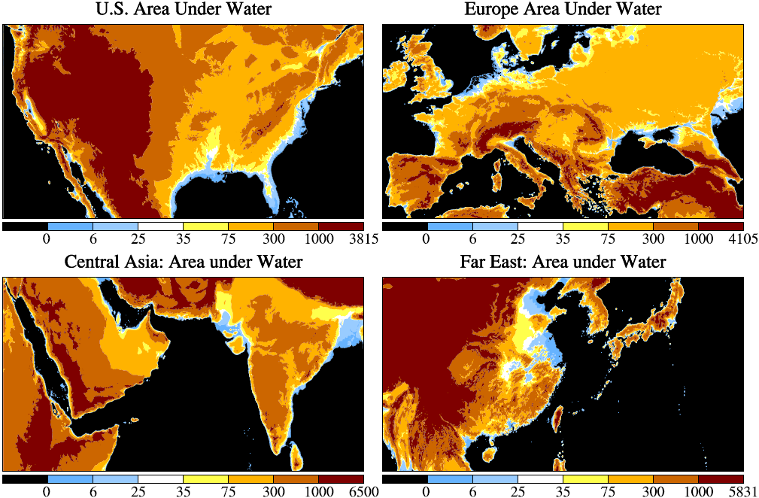
Notes:
Florida, the Netherlands and Bangladesh would be under water – also a good part of China.

Slide 35
Threat of Mass Exterminations
Multiple Human-Made Stresses Overharvesting, Land use changes, Nitrogen fertilization, Introducing exotic species, etc.
in Combination with
Rapid Shifting of Climate Zones
IPCC (2007) estimates that business-as-usual greenhouse gas emission will commit to extinction ¼ to ½ of all species.
Notes:
The second irreversible impact of rapid large climate change would be on other species.
We cause stress on other species in many ways as we take over the planet.
We could commit to extinction a quarter to half of all species from the combined effect of these stresses and rapidly shifting climatic zones, according to estimates of the Intergovernmental Panel on Climate Change.

Slide 36
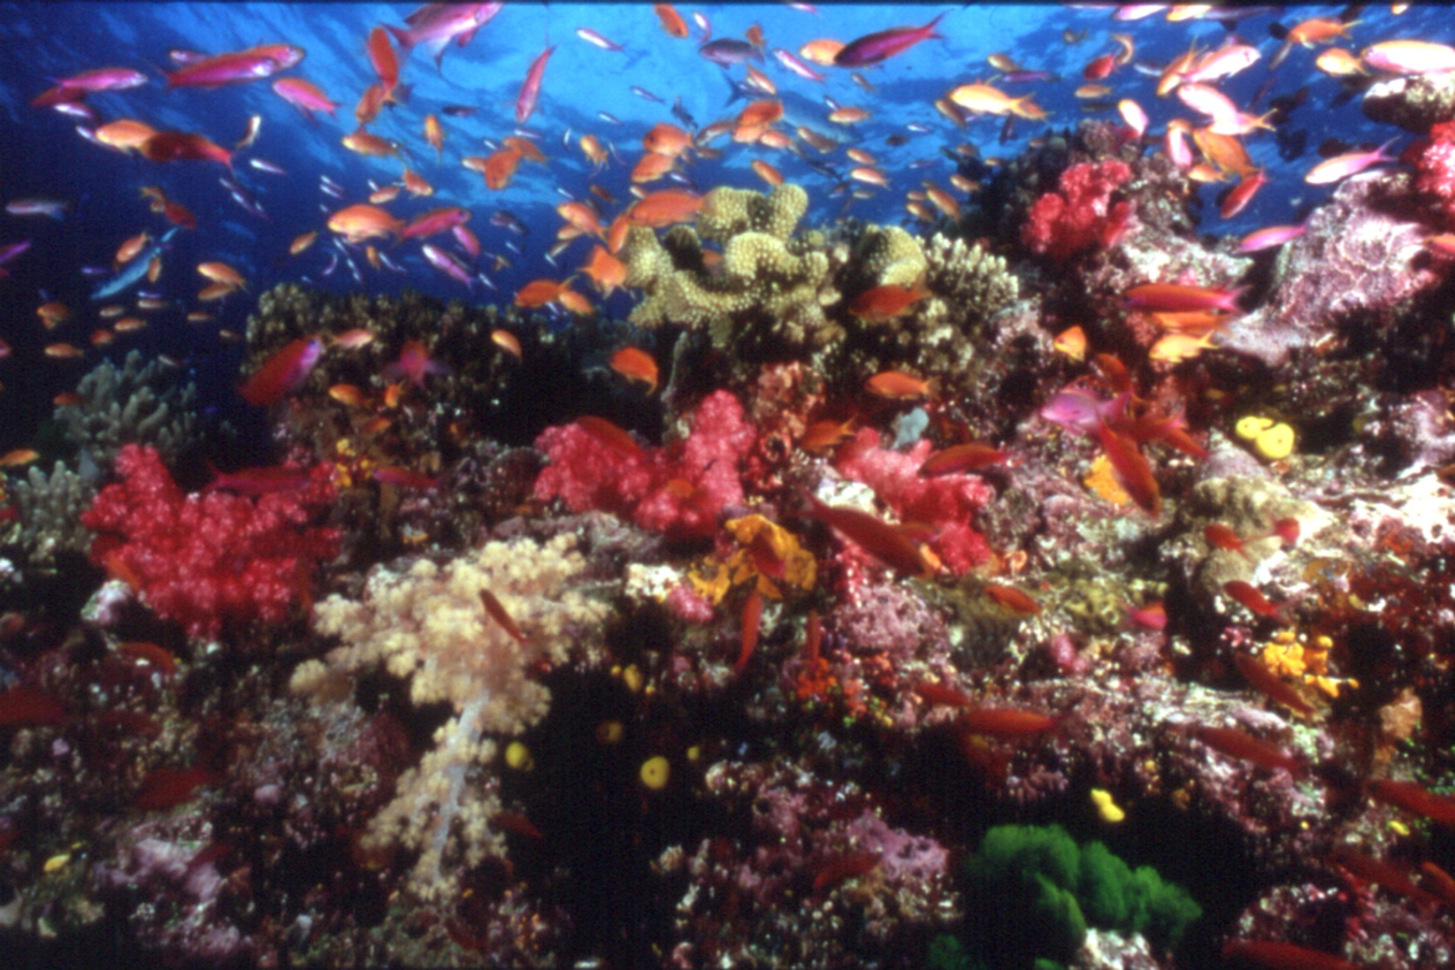
Stresses on Coral Reefs
Coral Reef off Fiji (Photo: Kevin Roland)
Notes:
Coral reefs are the rainforest of the ocean, harboring more than a million species.
They are threatened by many stresses including ocean warming, which causes coral bleaching, and ocean acidification, which, in the extreme can dissolve the carbonate exoskeletons. We are losing more than 1 percent of the coral each year.
If rapid emissions continue, especially with rapid sea level rise, most coral could be lost.
However, if we reduce CO₂ emissions to stabilize shorelines, we will also solve this problem.

Slide 37
Notes:
Older people notice that climate is changing, especially in summer.
Year-to-year variability of seasonal temperature in the 20th century formed a nice bell curve about the average, but now that bell curve has shifted.
What was an unusual extreme hot season last century is now much more likely to occur.

Slide 38
Notes:
The change depends on location. In middle latitudes, in the U.S. and Europe, the shift is a bit more than one standard deviation in summer, but smaller in winter.

Slide 39
Notes:
In the subtropics such as the Mediterranean and Middle East and Southwest United States, every summer is now hotter than average climate 50 years ago. That’s almost true in Southeast Asia.

Slide 40
Impacts of Shifting Bell Curves
1. Increase of Regional Climate Extremes
- Dry regions: Greater heat, drought, fire
- Wet regions/times: Greater rain, floods, storms
2. Summer Outdoor Livability Declines
- More than half non-household labor is outdoors
- Measurable impact on national economies
3. Conflicts, Violence Increase (Hsiang et al., 2013)
- Interpersonal: +4%/standard deviation
- Groups, Nations: +14 %/standard deviation
Notes:
Increased heat causes dry regions to have more drought and wildfires & a longer fire season.
But warm air holds more water, so wet regions and rainy seasons can have more extreme rain and floods.
Low latitudes are becoming less livable outdoors in the warm season, and more than half of the jobs are outdoors in agriculture or construction.
Higher temperatures also lead to a measurable increase of violence.

Slide 41
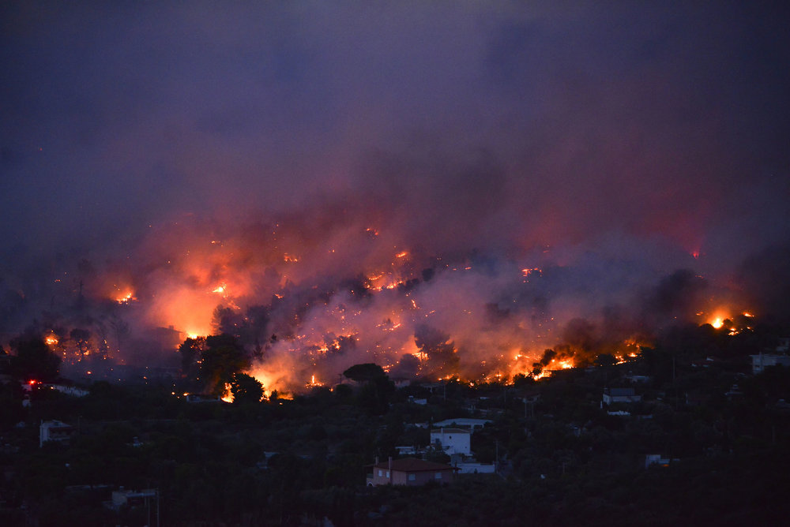
Flames rise as a wildfire burns in the town of Rafina, near Athens,
23 July 2018.
Photo by Angelos Tzortzinis/AFP/Getty Image
Notes:
These things are happening. Dry regions are having more extreme events. Here are fires in Greece.

Slide 42
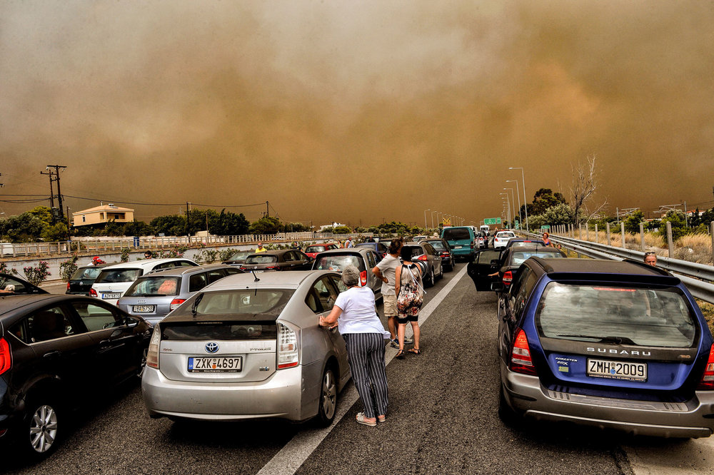
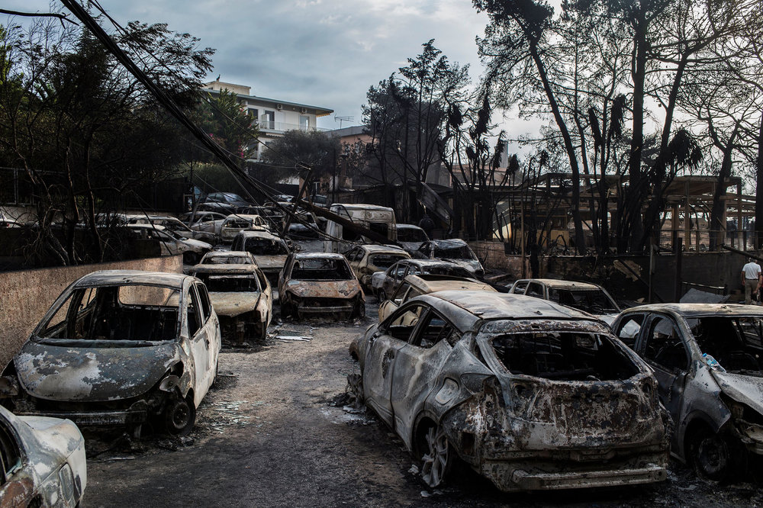
Photo by Valerie Gache/AFP/Getty
Cars blocked at closed National Road as wildfire rages in Kineta, west of Athens.
Photo by Angelos Tzortzinis/AFP/Getty
Charred cars lined a roadway in the village of Mati, east of Athens, July 24.
Notes:
More images from the fires in Greece.

Slide 43
Data source: National Interagency Fire Center 1960-2016: https://www.nifc.gov/fireInfo/fireInfo_stats_totalFires.html
Notes:
Fires have always occurred, but despite massive efforts to extinguish fires in the U.S., the area burned is increasing.

Slide 44
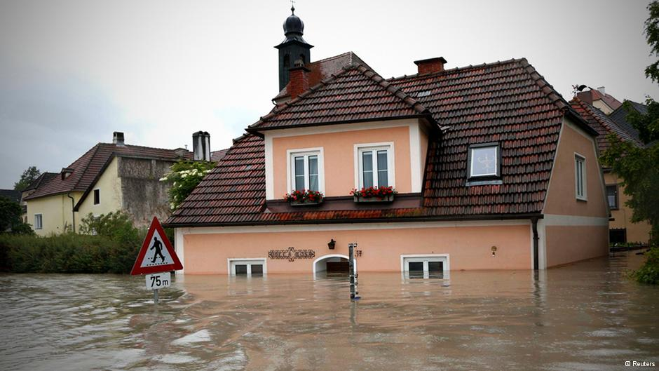
Flood in Germany, June 2013. Third “100-year flood” in 30 years.
Notes:
100-year floods are now occurring more than once a century.

Slide 45


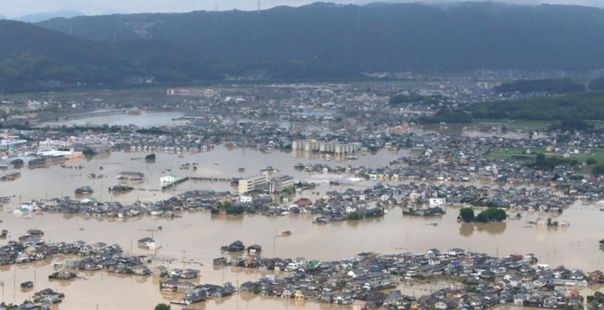
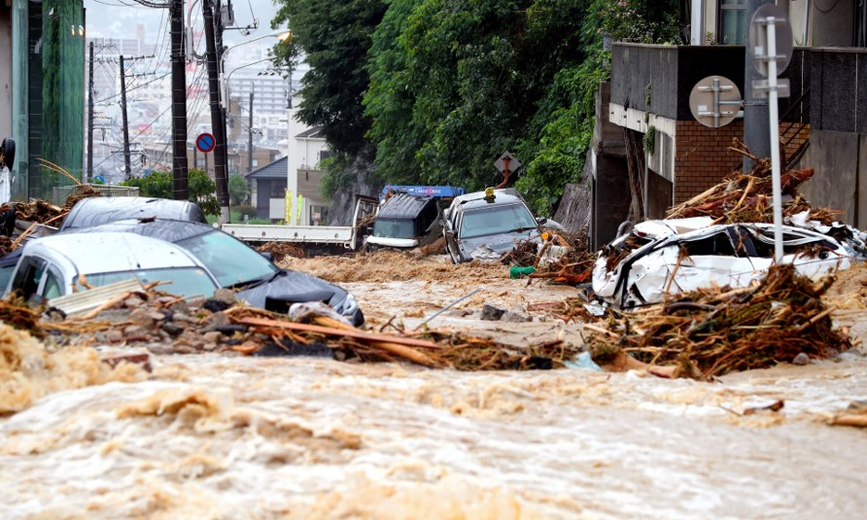
Historic Floods in Japan kill more than 100. Millions Forced to Flee, Okayama prefecture. 8 July 2018.
Rainfall in a few days was more than three times the normal amount for the entire month of July
Notes:
Unprecedented rainfall amounts in Japan.

Slide 46
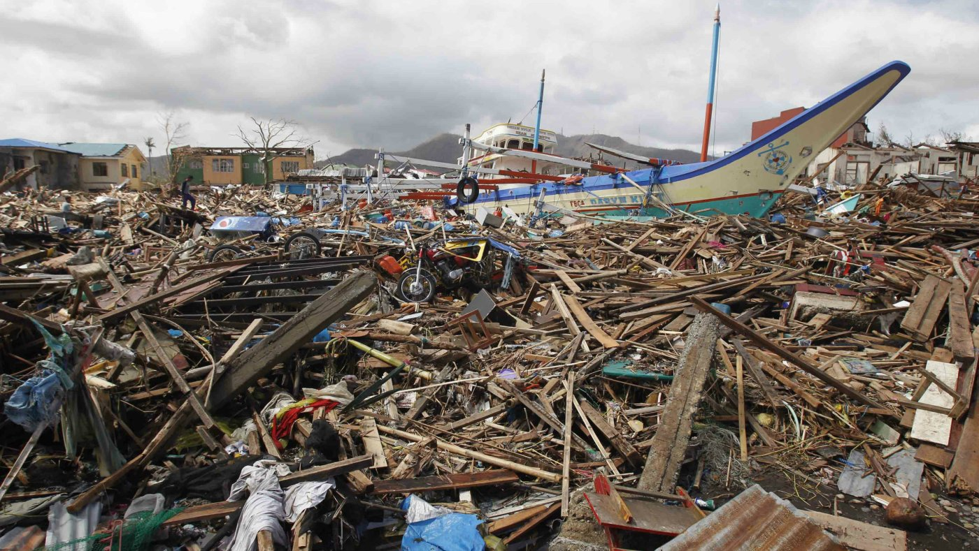

Photo by REUTERS/ROMEO RANOCO
Sustained measured winds of 195 mph, with gusts of 235 mph, made Super Typhoon Haiyan, known as Yolanda in the Philippines, the strongest storm ever recorded on land.
Photo by Joezel Constan
Notes:
A warmer ocean surface and more water vapor in a warmer atmosphere provide more fuel for stronger tropical storms, tornados and thunderstorms.
This super typhoon had the strongest sustained winds over land ever recorded, reaching 195 mph, well over 300 km per hour.

Slide 47
Climate Situation
Global Crisis, but not Recognized
Thermal Inertia → Warming in Pipeline
+
Amplifying Feedbacks → Losing Control
Notes:
Yet the urgency of the climate crisis is not recognized by most of the public.
Because of the ocean’s thermal inertia, much of the warming is still ‘in the pipeline’.
That warming will drive slow feedbacks, such as melting of permafrost and ice sheets.

Slide 48
Potential Injustices
1. Today’s Adults to Young People
- Because of continuing fossil fuel emissions → Climate Close to Being Out of Control
2. North to South
- North burned most of carbon budget
- Climate impacts largest at low latitudes
3. Humans to Other Species
- Climate change & other stresses
- Potential 25-50% extinctions
Notes:
So, if the world does not reduce fossil fuel emissions, it will be an injustice to young people, because we will hand them a situation out of their control.
It also would be an injustice of the industrial North, which is burning the allowable carbon budget for the entire world.
And an injustice of humans to all other species.

Slide 49

Notes:
Now you know why I got arrested.
After I was arrested five times I finally realized: “hey, this is not working!”
Drawing attention to the injustice of climate change does not alter government policies.

Slide 50
Hansen, J. and Kharecha, P., Cost of carbon capture: can young people bear the burden?, Joule 2, 1405-1407, 2018.
Notes:
Energy use continues to grow. People want to raise living standards. People want to travel, and they will. They need air conditioning. The world needs energy.
Governments give large subsidies to renewable energies, and pretend this will cause fossil fuel use to decline. Courage to use the true scientific method is lacking.

Slide 51
Fossil fuel emissions; purple are emissions through 2017.
1 GtC (gigaton carbon) = 1 billion tons of carbon or ~3.7 GtCO₂; 1 ppm CO₂ ~2.12 GtC
Update of Fig. 2 of Hansen et al., Assessing ‘dangerous climate change’, PLOS One, 8 (12), e81648, 2013. Error bars on reserves and resources, from reference 9 in that paper, likely are underestimates of uncertainty. Update is average of four recent assessments, available from author.
Notes:
So governments continue to seek fossil fuels, and there are plenty to find.
We have burned only the purple portion so far.
The science is crystal clear: we must leave most of the remaining carbon in the ground.

Slide 52
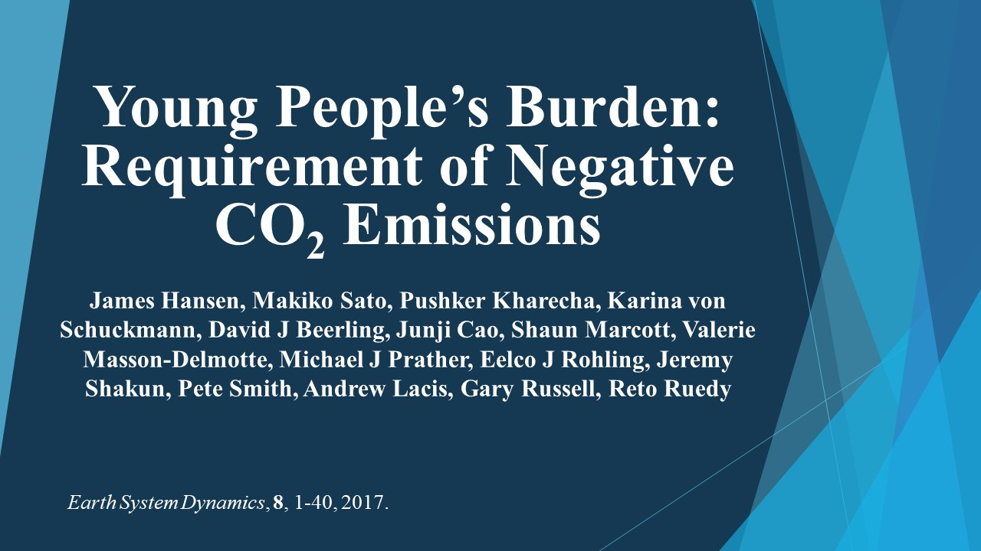
Notes:
And we must extract some CO₂ from the air, which is possible via improved agricultural and forestry practices.
However, we must leave young people a feasible task and tools to address it.

Slide 53
“Young People, do not underestimate your potential, aided by the Scientific Method, to change the World’s Course."
From Sophie’s Planet (coming soon)
Notes:
Young people must take up the fight and they must demand their rights.
But to succeed, they must understand the matter and use the scientific method.
We old scientists failed to change the world’s course. I hope to explain to young people what I learned in Sophie’s Planet.

Slide 54
Scientific Method
Study All Available Data on the Matter
Be Very Skeptical of Your Interpretation
Reassess from Scratch with any New Data
Your Preference, Your Ideology Must Not Affect Your Assessment
Notes:
The core of the scientific method is simple – in principle.
You must use all the data, be very skeptical of your interpretation, and honestly reassess from scratch when new data become available.
Your preference, your ideology, must not affect your assessment. It is difficult.

Slide 55
Evidence on the impact of sustained exposure to air pollution on life expectancy from China’s Huai River policy*
Yuyu Chen, Avraham Eberstein, Michael Greenstone and Hongbin Li
Principal finding: particulate air pollution caused by provision of free coal to 500 million residents in North China [north of Huai River] for winter heating for several decades reduced life expectancy of people in North China by 5.5 years.
*Proc. Natl. Acad. Sci. USA, 110, 6 August 2013
People north of line received free home-heating coal.
Notes:
Let’s now consider human health, as another huge issue associated with energy.
China did an inadvertent experiment by providing free coal for winter heating to people in North China for several decades.
It reduced their life expectancy by five and a half years.

Slide 56
Annual Deaths Attributable to Outdoor Air Pollution (WHO)
Lower Respiratory Disease
Lung Cancer
Obstructive Pulmonary Disease
Stroke
Heart Disease
Notes:
Globally, outdoor air pollution, mainly from fossil fuel burning, is killing more than three and a half million people per year. That’s 10,000 people per day.
The aerosols that people breathe are so tiny that they enter the blood stream, causing cardiac problems as well as respiratory problems.
Indoor air pollution, from burning of coal, wood and other biofuels, kills an additional 3.7 million people per year. Because these fuels are used for cooking, women and children are especially affected. Many of the deaths from air pollution are prolonged and painful, to the victim and the family.

Slide 57
Crucial Requirement
Abundant Clean Carbon-Free Energy
This can happen on the required scale, that is fossil fuels will be replaced, only if the entire energy system is economic relative to coal and gas
Notes:
The crucial requirement to solve both health and climate problems is abundant clean carbon-free energy.
However, fossil fuels will not be replaced by an alternative unless the entire energy system is economic relative to coal and gas, including costs of additional transmission lines and energy storage, if those are necessary.

Slide 58
Data through 2017. Source: BP (2018) Statistical Review of World Energy.
Notes:
India will soon pass China in population, and India will pass the U.S. in carbon emissions, becoming second to China.
Renewable energy, the green area, provides only a tiny portion of the energy. It cannot stop growth of fossil fuels, let alone cause their phase-out.

Slide 59
Sources: EIA Table E1 Estimated Primary Energy Consumption in the United States, 1635-1945
and EIA Table 1.3 Primary Energy Consumption Estimates by Source, 1949-2015.
Notes:
Energy history of the United States is educational. Wood was the first energy source, but coal, with greater energy density, powered the industrial revolution, until the more convenient liquid and gas fossil fuels were discovered.
Because fossil fuels are a finite resource, and a big pollution problem, it was hoped that peaceful use of nuclear power would be a major long-term energy source. There is enough nuclear fuel in the ocean to last forever, for billions of years, so it would be possible to stop mining of uranium.
Nuclear power could practically eliminate CO2 emissions, as well as air and water pollution. However, development of nuclear power practically stopped in the 1970s.

Slide 60
Biological Effect of Low Level Atomic Radiation
1. Threshold Criterion
- Doses comparable/less than natural radiation O.K.
- This was the Recommended Criterion until 1956
2. Radiation Hormesis: Positive Biologic Response
- Low radiation levels beneficial: stimulate activation of repair mechanisms that protect against disease
3. Linear-No-Threshold (LNT) Criterion
- Even the tiniest radiation presumed to be harmful
- NAS BEAR Committee recommended LNT in 1956
Notes:
What happened? The root problem for nuclear power is concern about health effects of atomic radiation.
Until 1956 it was assumed that there was a threshold for harm, consistent with the idea that radiation is probably not dangerous if it is less than the amount that we get from cosmic rays and radioactive elements in the soil.
Some scientists even argue for radiation hormesis, the idea that low levels of radiation are beneficial.
However, in 1956 the National Academy of Sciences BEAR Committee, Biological Effects of Atomic Radiation, declared that the tiniest amount of radiation is harmful.

Slide 61
Public Concern About Radiation
Atmospheric Tests of Nuclear Bombs
Concern about radioactive fallout from nuclear weapons testing helped spur the Limited Test Ban Treaty in 1963.
China Syndrome + Three-Mile-Island Accident
Popular film about the danger of a nuclear core meltdown.
Actual accident exposed Pennsylvania residents to radiation
Notes:
Linus Pauling used the idea that even the tiniest radiation is harmful to help achieve a ban on atmospheric testing of nuclear weapons by the U.S. and USSR. This incidentally had an effect on public perception of nuclear power.
Public attitudes were also affected by the 1979 disaster thriller film, The China Syndrome, about the danger of a nuclear meltdown.

Slide 62

Notes:
This film almost coincided with an actual accident and partial core meltdown at the Three-Mile-Island power plant in Pennsylvania.
Enthusiasm for nuclear power in the U.S. dissipated, even though it was determined later that the radiation released did not harm Pennsylvania residents.

Slide 63

Notes:
This is from a concert held that year in New York.
Did you hear the line in the song “give me the warm glow of a wood fire”? Remember that 10,000 people per day are dying from indoor air pollution.

Slide 64
Biological Effect of Low Level Atomic Radiation
1. Threshold Criterion
- Doses comparable/less than natural radiation O.K.
- This was the Recommended Criterion until 1956
2. Radiation Hormesis: Positive Biologic Response
- Low radiation levels beneficial: stimulate activation of repair mechanisms that protect against disease
3. Linear-No-Threshold (LNT) Criterion
- Even the tiniest radiation presumed to be harmful
- NAS BEAR Committee recommended LNT in 1956
Notes:
Proponents of nuclear power continue to argue that the BEAR Committee was wrong, that LNT is not correct and was ideologically driven.
I doubt that this battle will be fruitful. Small radiation effects are difficult to prove and depend on the circumstances. In such case, health professionals are likely to prefer the strictest criterion, which is LNT.
However, young people have a good basis to be very unhappy with us old people for not being scientific, for not being objective.
We owe it to young people to provide an honest comparison of the health and environmental effects of nuclear power, health and environmental effects of fossil fuels, and health and environmental effects of renewable energies. We have science academies capable of such evaluations, which should be presented side-by-side.

Slide 65
“We are eliminating programs that are no longer needed, such as nuclear power research and development.”
President William Clinton,
1993 State of the Union address
Argonne National Laboratory was ready to construct a commercial-scale reactor that:
Burns >90% of nuclear fuel, compared with ~1% in existing reactors,
Can utilize nuclear waste, depleted uranium and excess weapons material as fuel,
Leaves less waste, which can be disposed of safely,
(4) Can shut down automatically in the event of an anomaly (e.g., earthquake),
(5) Does not require power to cool reactor in case of shut down,
(6) Does not require uranium mining for centuries; indeed, it has been shown that fuel can be sieved from the ocean – the supply will last billions of years.
Notes:
Young people have more reason to question the wisdom of us old people.
President Clinton, 25 years ago, terminated R&D on nuclear power, just when the Department of Energy was ready to build an advanced generation nuclear reactor with major improvements over today’s reactors, which are 50 year old technology.
Nuclear power in the U.S. has an outstanding safety record, but next generation nuclear power can be even much safer and produce less nuclear waste. We would not force solar energy or windmills to use 50-year-old technology.

Slide 66
Another Potential Technology
Thorium-Powered Molten Salt Reactor
Operates near Atmospheric Pressure
Factory or Shipyard Construction
Inexhaustible Fuel Supply
Reduced Waste, Shorter Half-Life
Passively Safe Operation
Not Well-Suited for Weapons Material
Notes:
I am not advocating any specific technology. My opinion is that, because of prior government failure to support R&D, the best chance for advanced technology to contribute to rapid phasedown of CO2 emissions, in the near-term, is probably via modular light-water reactors.
However, the Nuclear Regulatory Commission and the Department of Energy need to facilitate progress with modern technology, which they are not doing well. Canada has a more responsive regulatory commission. Yet, from an engineering perspective, the best nuclear innovation potential still seems to be in the U.S.

Slide 67
Grandsons Connor and Jake – Connor reading Indiana Jones book.
Notes:
Let me give the last word on this topic to my oldest grandson, here at about age seven reading an Indiana Jones book about an urgent problem.

Slide 68
Connor’s Thoughts
If we keep doing what we are doing now then the environment will be ruined when the people who are kids now are grownups.
And unless we can figure out how to make a time machine that actually works, there will be no way to go back in time to fix it.
It’s not fair that the grownups now are ruining the atmosphere for the grownup in the future.
Grownups now are scared of nuclear power but they should be scared of what will happen if they keep doing what they’re doing now because we know the ways to use nuclear power safe and we know that using fossil fuels is not safe. It is very dangerous.
Notes:
A few years later Connor correctly identified two basic conclusions about the energy/climate matter.
First, if grownups keep doing what they’re doing, and kids can’t figure out a time machine that actually works, kids are screwed.
Second, some grownups are scared of nuclear power – but what about fossil fuels? We know that using fossil fuels is not safe. It is very dangerous!

Slide 69
Solution
Fossil Fuel Price Must Include Costs to Society
- Human Health & Climate Change Costs
- Practical Solution: Rising Carbon Fee
Notes:
Now let’s consider the solution to the health and climate problems. The essential requirement is a rising carbon fee, to make the price of fossil fuels honest, by including their human health and climate change costs.

Slide 70
Carbon Fee & Dividend
Fee: Collected at Domestic Mine/Port of Entry
Covers all Oil, Gas, Coal → No Leakage
Dividend: Equal Shares to All Legal Residents
Effect is “progressive”; Low-income people gain
Merits:
Transparent; Public can understand & support it
Market-based; Stimulates Innovation
Notes:
It is easy to implement an across-the-board carbon fee, collecting it at the first sale at domestic mines and ports-of-entry.
If 100 percent of this collected fee is distributed equally to all legal residents, we obtain a simple, transparent, market-based approach that spurs innovation.
With the present distribution of energy use, 70 percent of the public will make money, but if they want to stay on the positive side of the ledger they need to pay attention to the price of things on the shelf – products that employ a lot of fossil fuel in their production will become more expensive.
Most rich people have a large carbon footprint, from large houses and flying around the world, so they will lose money, but they can afford it.

Slide 71
Carbon Fee & Dividend Addresses
1. Economy: Stimulates It
Puts Money in Public’s Hands
Provides Certainty to Businesses and Entrepreneurs
2. Energy: Solves Fossil Fuel Addiction
Stimulates Innovation – Fastest Route to Clean Energy
Complements Efficiency Regulations & Energy RD&D
3. Climate: Viable International Approach
Border Duties on Products from Nations w/o Carbon Fee
Rebate Industry on Exports to Nations w/o Carbon Fee
Notes:
Fee & Dividend spurs the economy, creating jobs, increasing GNP and increasing government revenue.
Fee & Dividend is the one effective international approach. When the U.S. and/or China adopt a carbon fee, they will also impose border duties on products from countries that do not have an equivalent carbon fee. That will be an incentive for other countries to adopt a carbon fee, so they can collect the money themselves.

Slide 72
Solution
Fossil Fuel Price Must Include Costs to Society
- Human Health & Climate Change Costs
- Practical Solution: Rising Carbon Fee
2. Some Regulations Still Required
- Refrigerator Efficiency, for example
- No Power Use by Idle Electronic Products
3. Technology Development Needed
- Rising Carbon Fee Will Spur Tech Development
- but Government must Facilitate Long-Lead RD&D
Notes:
So the crucial underlying requirement is a rising price on carbon, to make the fossil fuel price honest.
Some regulations will still be required, and governments must support research and development, because it is essential to have 100 percent carbon-free electricity.

Slide 73
Update of Fig. 6 of Hansen and Sato, Regional Climate Change and national responsibilities, Environ. Res. Lett., 11, 2016.
Proportionality of global warming to cumulative emissions was shown by Hansen et al., Dangerous human-made interference with climate: a GISS modelE study, Atmos. Chem. Phys., 7, 2287-2312, 2007.
Notes:
It’s important to recognize national responsibilities for climate change, which is proportional to cumulative emissions. The U.S., the UK and Germany are much more responsible for climate change than the developing countries. In other words, the West burned much more than its fair share of the global carbon budget that is permitted if we are to stabilize climate and avert disasters.
This is an added reason for the West to assist in reducing emissions in developing countries, in addition to the fact that we are all in the same boat together.

Slide 74
Data through 2017. Source: BP (2018) Statistical Review of World Energy.
Notes:
How can we reduce emissions from the big future emitters? If I want to be popular, if I want to find research support easily, I must say that renewable energies can provide all of our energy.
If I want to be a good scientist, I must look at the data. Does it make sense to place all our eggs in one basket, to make the assumption that renewable energies by themselves will rapidly replace fossil fuels?
Young people should be angry. Old people do not have the right to gamble the future of young people on that assumption.

Slide 75
Trilateral Agreement Needed: China, U.S., India
Rising Internal Carbon Fees
- Spurs life style changes & Innovation
- Stimulates economies
Border Duty on Products from Nations w/o Fee
- WTO rules allow equivalent duty
- Strong incentive for others to join
Technology Cooperation Required
- Includes advanced generation nuclear power
Notes:
I doubt that the climate problem will be solved by 190 nations sitting around a table. What is required, I believe, is the United States and China to agree on the need for a carbon fee. They could readily impose it on a near-global basis.
However, this will not happen in the absence of technological advances that allow practical economical movement to carbon-free electricity in countries such as China and India. For that to happen rapidly requires concerted, high-priority technology cooperation.
The notion that humanity can escape to Mars is nonsense. Either we learn to work together preserving our remarkable home planet, or we sink to the abyss together.

Slide 76

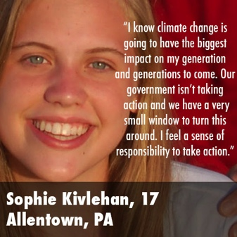
FEDERAL LAWSUIT:
U.S. District Court, District of Oregon:
Trial Begins October 29, 2018
Plaintiffs: 21 U.S. Youth & Future Generations
Defendants: U.S. President & Federal Agencies
Constitutional Basis: Due Process, Equal Protection, and Public Trust Doctrine
Seeking: Science-based National Climate Recovery Plan
Notes:
China and India are not the only big emitters. There is also the United States, which has withdrawn from the Paris Agreement and says that climate change is a hoax.
Nevertheless, there is a basis for optimism. The United States is still a nation of laws. Twenty-one young people, including my oldest grandchild, and I have filed a lawsuit against the federal government demanding a national plan to phase down emissions rapidly.
I expect that we will win this case even with a conservative Supreme Court, because our case is based on the most fundamental Constitutional principles: young people are being deprived of life, liberty and property without due process of law; they are not receiving equal protection of the law. It is analogous to the case of civil rights in the 20th century.

Slide 77
CitizensClimateLobby.org
Citizens Climate Lobby is a volunteer nonprofit organization advocating for Carbon Fee and Dividend, which would place a steadily-rising fee on the carbon dioxide content of fuels and distribute all the revenue to households as equal payments.
CCL now has more than 400 chapters with more than 90,000 members in 30 countries and is growing rapidly.
Please visit CitizensClimateLobby.org and consider joining!
Notes:
But the courts cannot write laws, so it is important to also influence the legislative branch.
Good progress is being made in the U.S. by a rapidly growing organization, CitizensClimateLobby, which has Carbon Fee & Dividend as its objective.
CCL uses the democratic process, it visits Washington, speaking to Congress people and their staffers about fee-and-dividend. They also write op-eds and letters-to-the-editor.
Joining this organization is probably the single most important thing a citizen can do to address climate change.
There are CCL branches in India, but not in China or Taiwan. Something to consider! Thank you!

Slide 78
Discussion Available at:
www.Columbia.edu/~jeh1

Slide 79
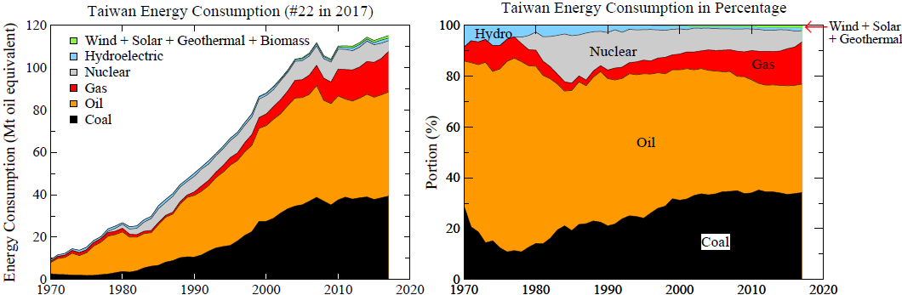
Source: BP (2018) "Statistical Review of World Energy
Total" Total = 115.1 Mt oil equivalent, Nuclear = 5.1 = 4.4%, Hydro = 1.2 = 1.0%, Other renewables = 1.2 = 1.0%
https://www.bp.com/en/global/corporate/energy-economics/statistical-review-of-world-energy.html
Notes:
Total = 115.1 Mt oil equivalent
Nuclear = 5.1 = 4.4%
Hydro = 1.2 = 1.0%
Other renewables = 1.2 = 1.0%

