Slide 1
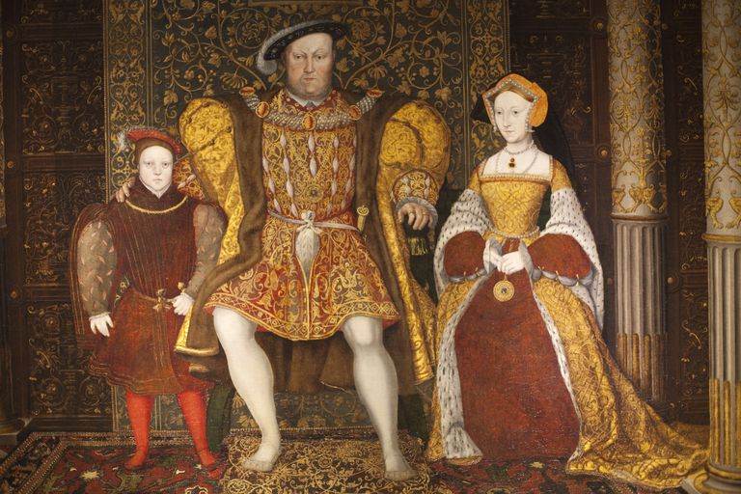
Tudor Troubles

Slide 2
Christendom Recap
Church and State?
Clergy and Laity?
Christ and Church?
Scripture, Tradition, and Magisterium [Teaching Authority]?
Does the Body work?

Slide 3
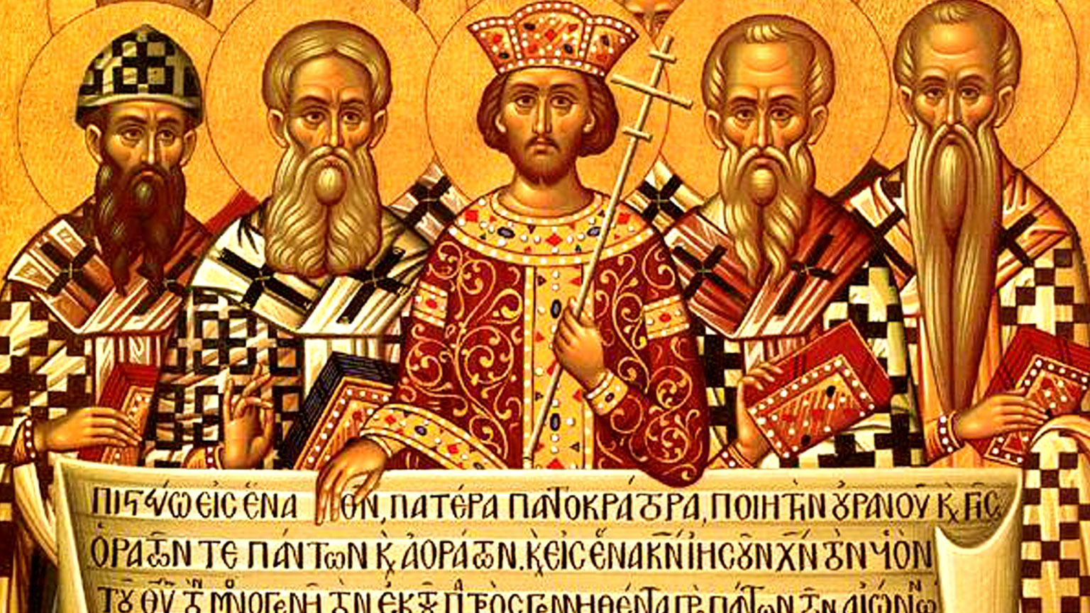
Sovereignty: A Conceptual Question
Sovereign is the one who decides…but who? King? Church? Godly? Councils?
Who Interprets?: Church (hierarchy or laity? Educated or the ‘Catholic’ [whole] Church?
Qui Custodiet Ipsos Custodes?: Law, Tradition and Scripture

Slide 4
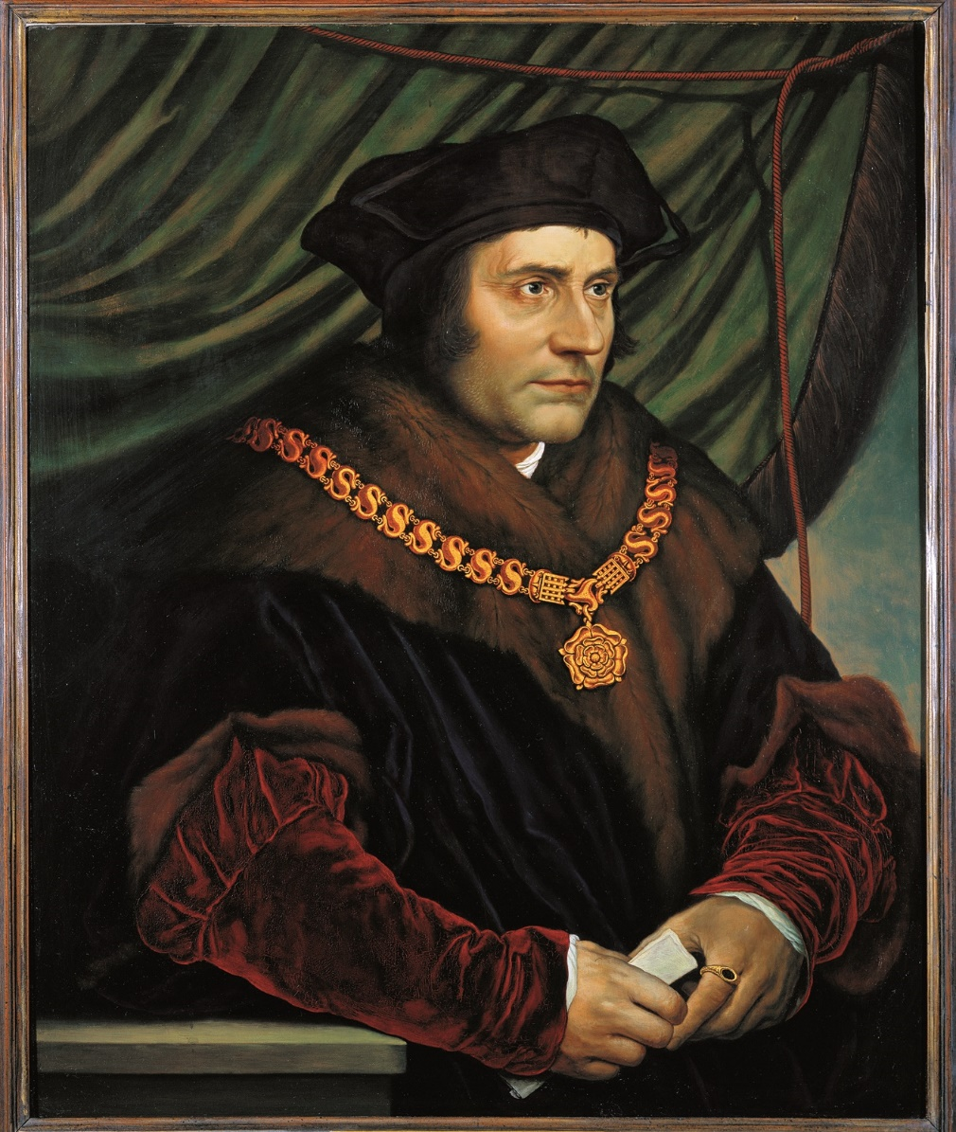
Humanism in England
Friends of Erasmus: Collet, More, Fisher, Tunstall
An English Renaissance: increased learning, lay piety, ad fontes, a republic of letters
Tunstall and Tyndale: Humanism not necessary friendly to Reformation (fear of Lollardy)

Slide 5
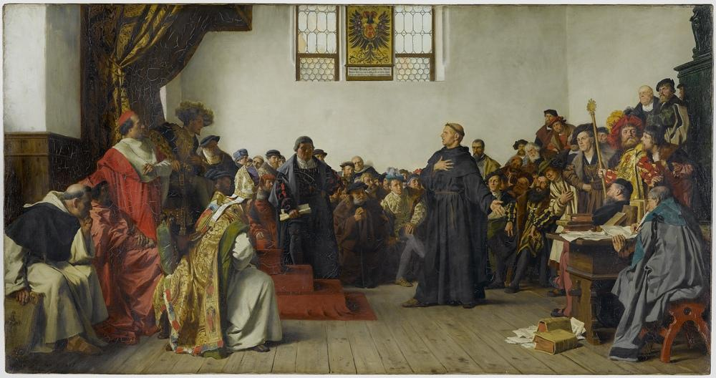
Evangelicals: The Protestant Reformation
Oct. 31 1517: Luther, 95 Theses, and the eruption of troubles
Swiss Reformation: Zwingli and Humanism
“Little Germany”: Tyndale and the growth of an English Reformation
“This damnable and rotten worm”: Luther and Henry, Defensor Fidei

Slide 6
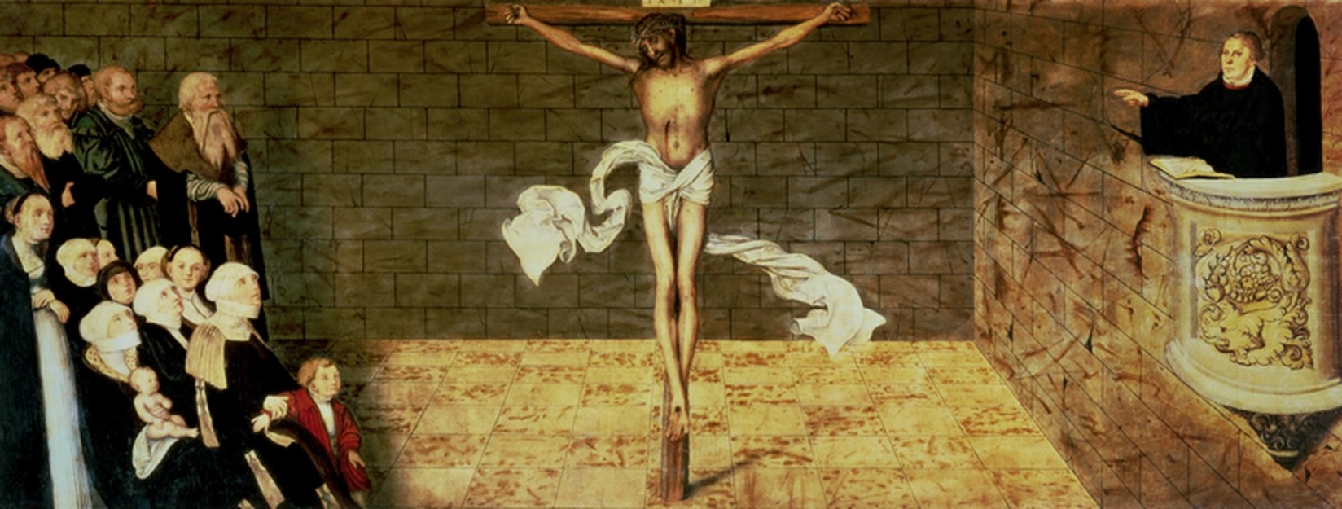
5 Solae: Traits and Consequences
Sola Gratia [Grace Alone]: Role of good works?
Sola Fide [By Faith Alone]: Christ and Church?
Sola Scriptura [Scripture Alone]: Role of Tradition?
Solus Christus [Christ Alone]: Salvation?
Soli Deo Gloria [Glory to God Alone]: Prayers? Saints?

Slide 7
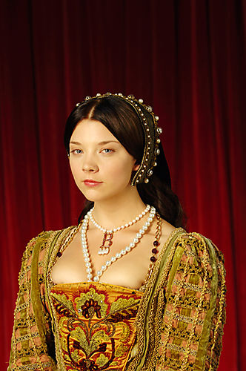
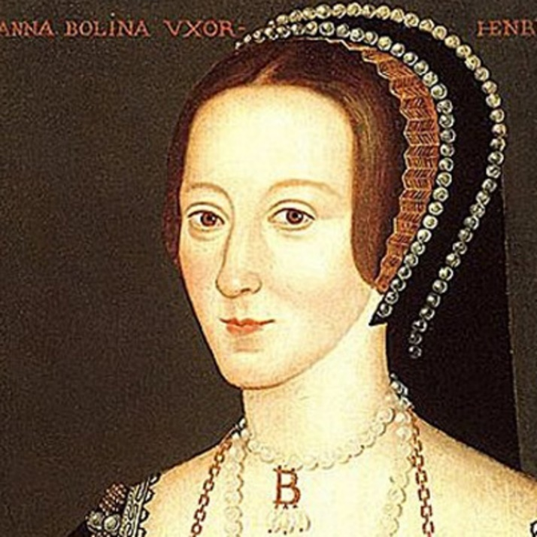
Henry’s Turn From Rome
“The King’s Great Matter”: Habsburgs, Papal Politics, and a King’s Conscience
God’s Curse?: The Dilemma of a Sonless Tudor
The Fall of Woseley & the Rise of the Boelyns
“A Man for All Seasons”: The Fall of Thomas More and Reformation Parliament(s)

Slide 8
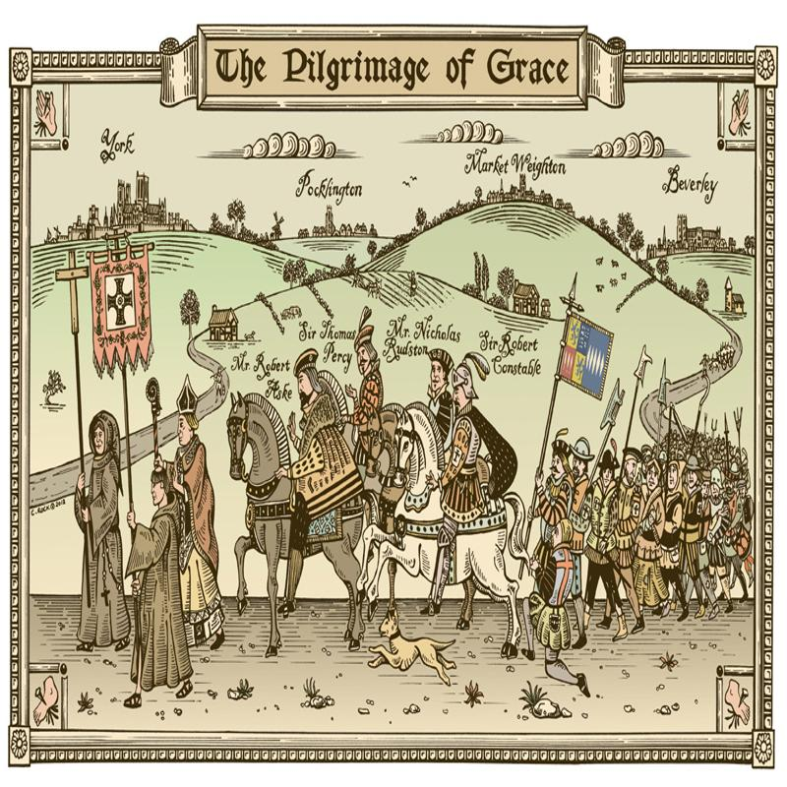
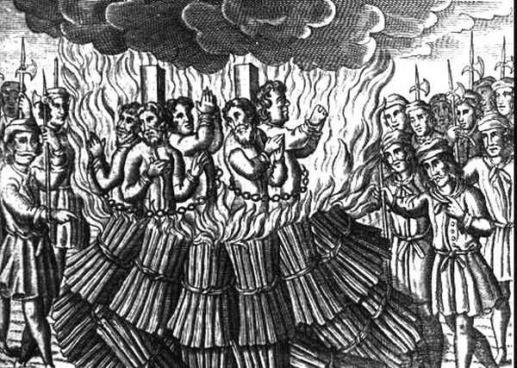
The Henrician reforms
Dissolution of the monasteries: Qui Bono?
A Tudor Revolution?: The Career of Thomas Cromwell
Pilgrimage of Grace: Catholic or Popular Resistance?
A reformation or the Reformation?: A distinction
The Conservative Turn: The burning of 6 Heretics

Slide 9
Summary of Henrician Reforms
While linked and attached to the Reformation, Henry’s reforms were of a piece, a reformation (in line with previous Medieval reforms of church and state); Evangelicals were able helpers in this, but not drivers
Reformation had a small clique of adherents, but spread of the Henrician reforms and Reformation was top-down, imposed from above; However, this required active reception from below
Henry’s reforms empowered both conservatives and evangelicals

