Slide 1
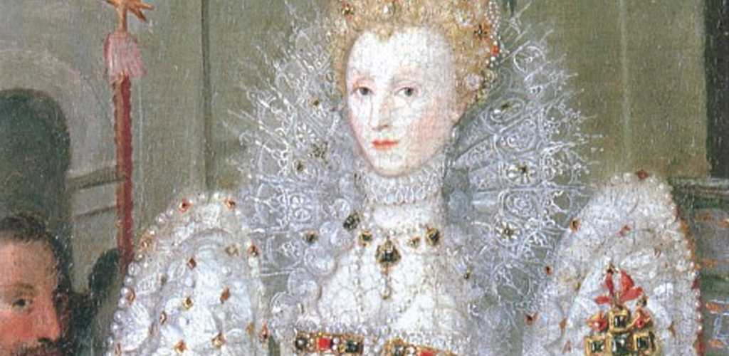
The Age of Elizabeth: Gloriana or Bad Queen Bess?

Slide 2
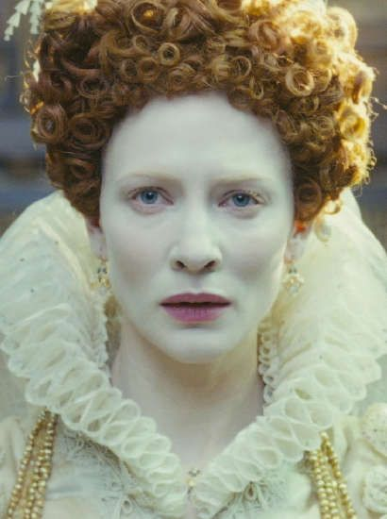
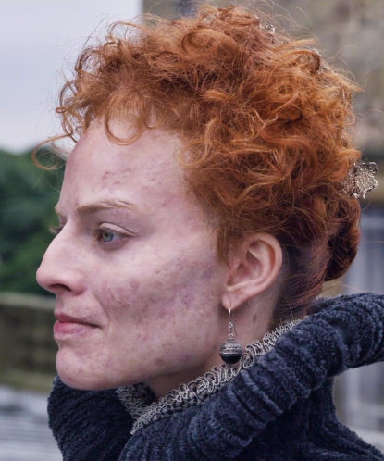
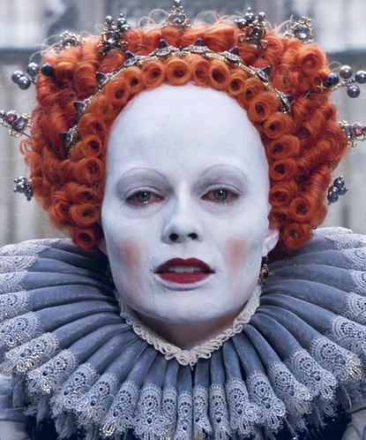
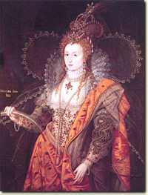
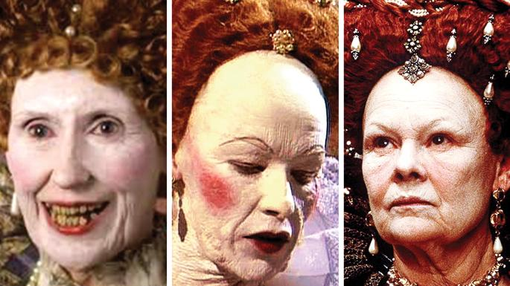

Slide 3
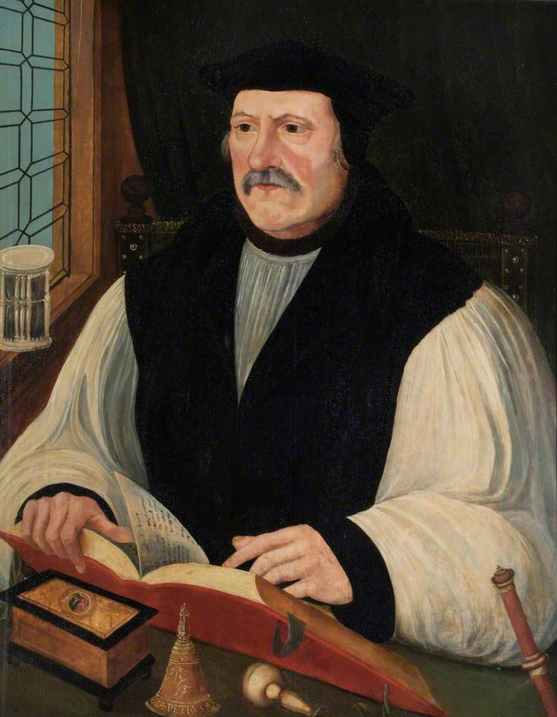
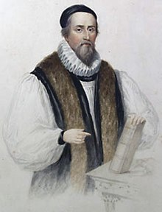
The Protestant Queen(?)
Church of England reforms: 39 Articles, 1559 Book of Common Prayer, Crown as Supreme Governor
Church Hierarchy: Nicodemites and Exiles
Reformation: Edward or More?
Elizabeth’s Idiosyncrasies

Slide 4
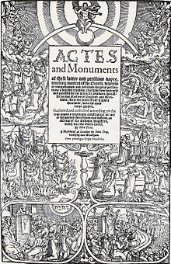
The Reformation Binary: Rome vs. Reform
Scripture Alone?: Role of Tradition and Adiaphora, but who interpreted?
Faith Alone?: Role of Good works in process of salvation, but who would be saved?
The Hierarchy?: Priesthood of Believers, but who ruled?
Christ Alone?: Sacramental Grace, but how? And what was role of word of God?

Slide 5
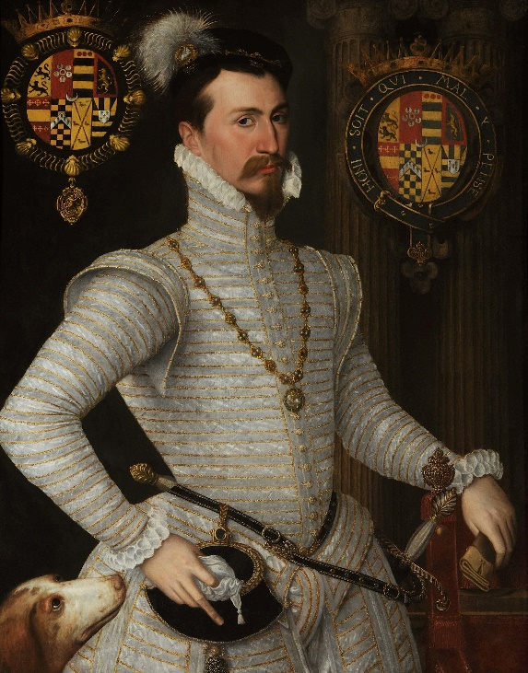
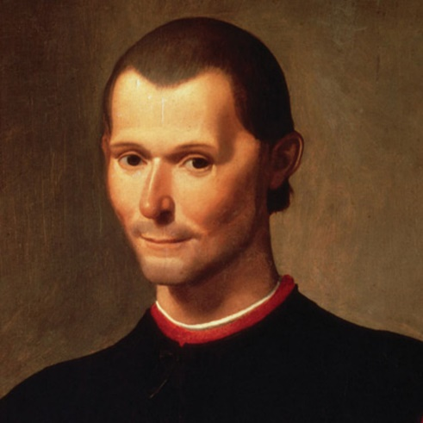
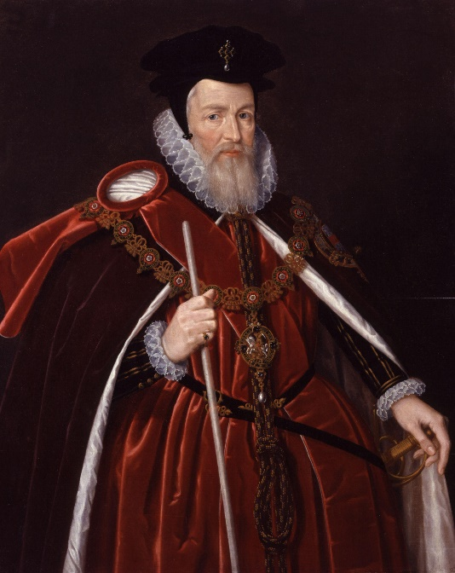
Renaissance Politics: The Machiavellian Moment
What is Politics?
Role of “History”: Between Antiquity and Modernity
From Ideal King to Machiavellian Prince: Who are you really?
To Out Machiavelli the Machiavellians: Politics as Judgement

Slide 6
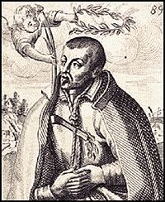
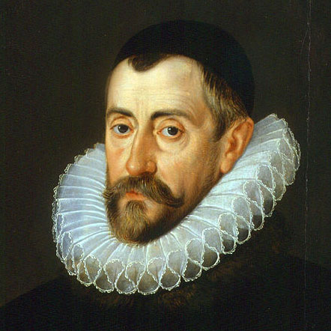
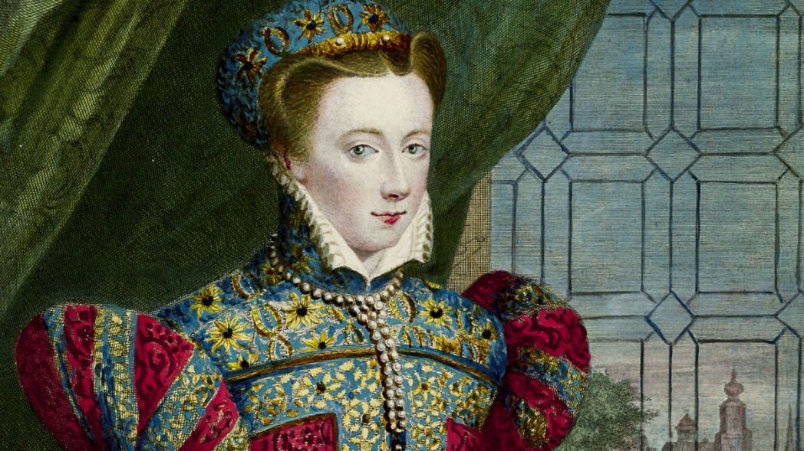
The Elizabethan Politics: Godly Monarch or Corrupt Cabal?
The Commonwealthmen: Was Elizabethan England a “republic”?
The Reformation: Why more? Why less?
Between Consensual Politics and Adversarial Politics: A Growing Epistemological Divide
The Fall of Mary Queen of Scots: A Test Case?

Slide 7
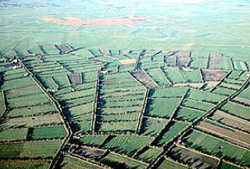
Elizabethan Economics
Monetarism and Credit: What is value? Impact on the Commons
England as an “Empire” means England as Empire: Mercantilism and the royal interest in colonies
Enclosure & Woolens: A New Economic Future or Destruction of the Commons?

Slide 8
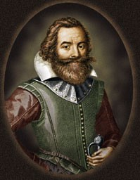
Like Spain but Different?: England in America
Spanish Empire: Conquest of Aztec and Inca; Black Legend
Virginia, a New Mexico?: Search for Empire
A Free, Protestant, Merchant Empire: A Rival Vision or Jealousy?
Discovery of Tobacco: Beginning of Plantation Economics

Slide 9
What was Elizabethan England?
Increasingly Modern or Medieval?
How Reformed/Protestant was England?
Was England a “republic” or a Tudor-style monarchy?
Was the Commons being transformed for good or bad or both?

