Slide 1
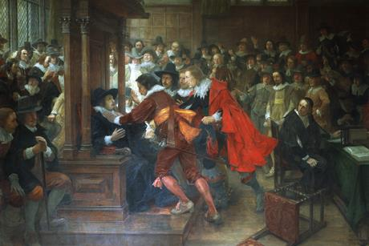
The Stuart Storm

Slide 2
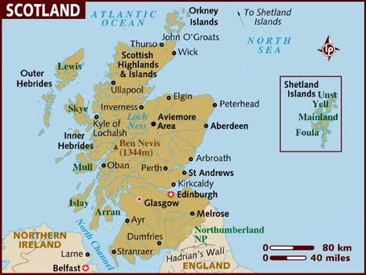
Background: Scotland
English and Scottish Hatred: Northern Bandits vs. Southern Dandies
Unicameral Parliament: Mix of Lords and Wealthy Commoners (Royal Burghs)
English wealth and influence: Lowlands vs. Highlands
John Knox: Presbyterian Revolutionary and “the Kirk”

Slide 3
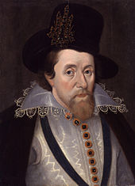
James I: Brief Bio
The Scottish heir: son of Mary, successor by Cecil
“No Bishop, No King”: James rejects Buchanan
Rex Pacificus: scholar, connoisseur, lover(?)

Slide 4
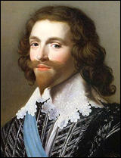
“I have my George”: Favorites as Politics
“Like a poor man wandering”: Rise in courtly expenses
“Self government at the King’s Command”: the Elizabethan Republic of Offices and Absolutism
Favorite as Patronage System: Rise of Buckingham
Overbury Affair: Political Intrigue?

Slide 5
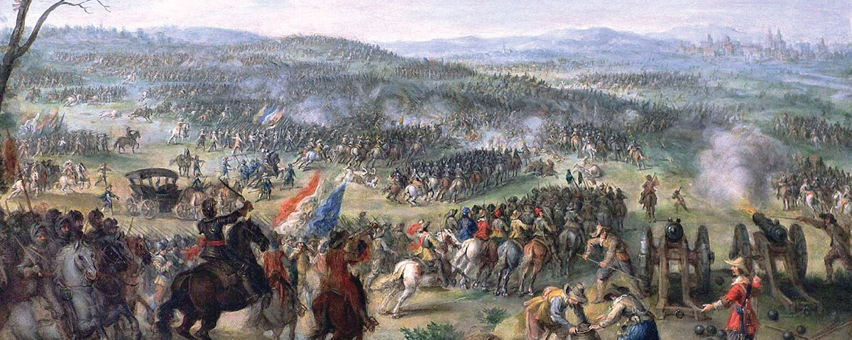
30 Years War (1618-1648): Brief Context
Peace of Augsburg (1555): German ceasefire and confessional hardening
80 Years War: Dutch Independence and the Habsburgs
“The Winter King”: Rise and fall of king Frederick (married to James’ daughter), Battle of White Mountain (1620)
English Patriotism: The Protestant Kingdom

Slide 6
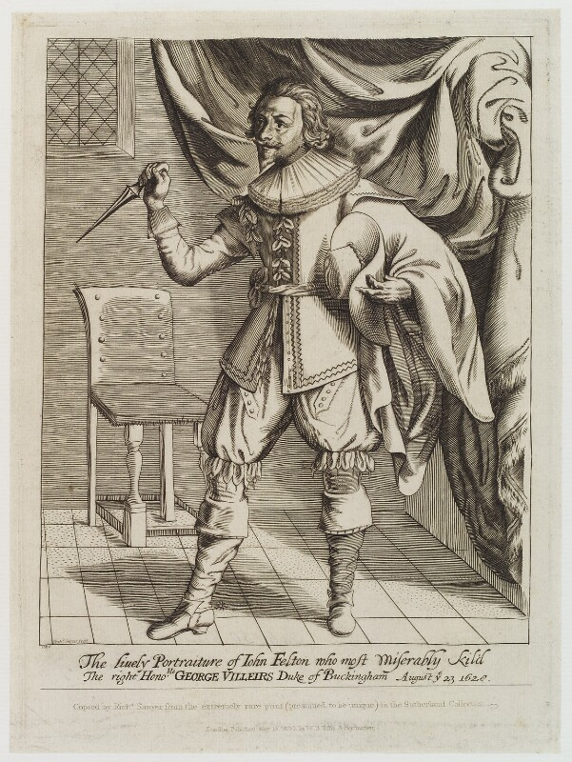
“The Blessed Revolution”: English Patriotism
Constitutional Questions: Role of Parliament and Common Law?
Charles and Buckingham: Parliamentary Politics as Tool
Royal Failure: English military losses, Charles takes blame (as king!)
Puritan Patriotism?: John Felton and the Fall of Buckingham (1628)

Slide 7
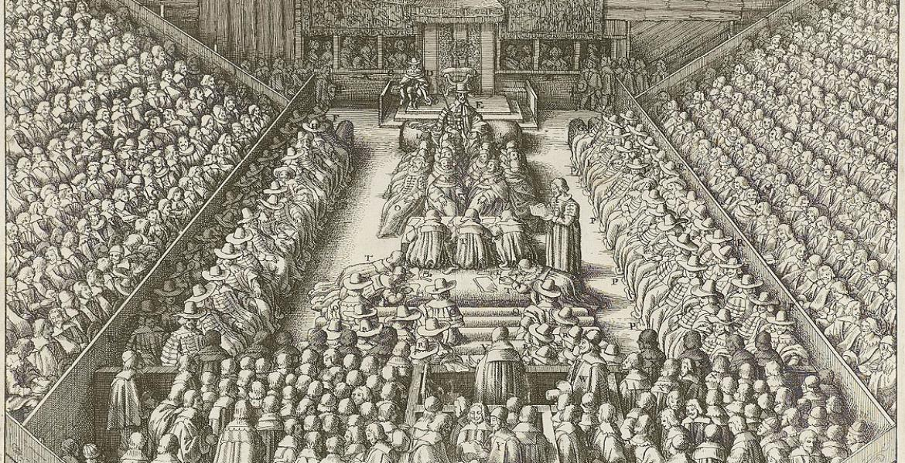
From Parliamentary Selection to Election
MPs “selected”: The best men from local patronage
Consensus and Faction: How to resolve conflicts?
Royal Involvement in Parliament: Charles as Politician?
Shift to Election: Voting as Contest

Slide 8
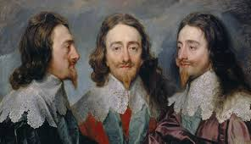
Charles I: Brief Bio
2nd Son Syndrome?: Charles as royal exemplar and virtuous, but focused on royal prerogatives
Charles as Protestant: An Advocate of “Laudianism” and limited toleration, but solidly Protestant (NOT a Catholic)
A narrow mind?: Stoicism as political practice, Henrietta Maria as political councilor
Two philosophies: Charles the Wise and Charles the Politician

Slide 9
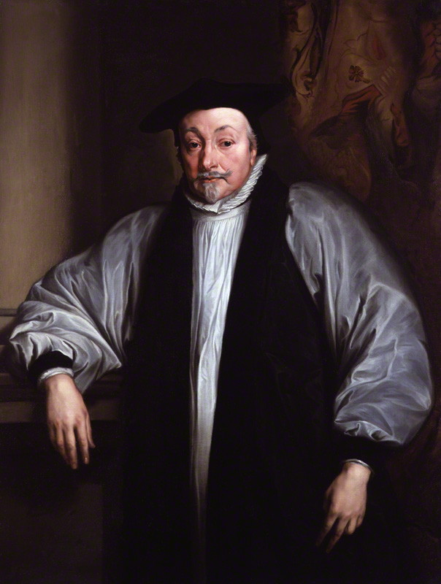
Laudianism: A Conservative Revolution?
Hookerian Precedent: England’s Church is best Reformed Church
“Beauty of Holiness”: The English Catholic memory and role of the tactile in worship (east-facing altars, crosses, a hieratic clergy)
“Anti-Calvinist”?: The Problems of Predestination, not Arminianism
Puritan Hostility: A return to Popery?

Slide 10
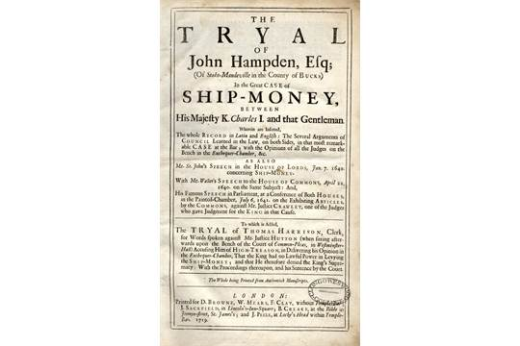
The Personal Rule
“You Shall Sit as Long as the House pleases!”: Parliamentary privilege and its abjuring in 1628
Ship Money: The King’s mounting financial crisis
The Laudian Hierarchy: Fueling puritan radicalism and the turn towards Presbyterianism (different from Scottish version)
“Blood of the Martyrs”?: Understanding Prynne and Laud

