Slide 1
My life
Reporter: Kevin
Time: 10mins

Slide 2
Outline
Home country
Family
Military life
Q&A

Slide 3
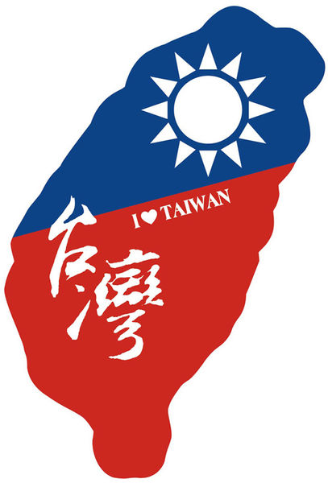
Home country
Taiwan is a oceanic country.
Used to call Formosa “The most beautiful island”.
The population of Taiwan is 23 millions.
Close to China, Japan and South Korea.
Taipei 101 Building
Sun Moon lake
LiuQiu Island

Slide 4
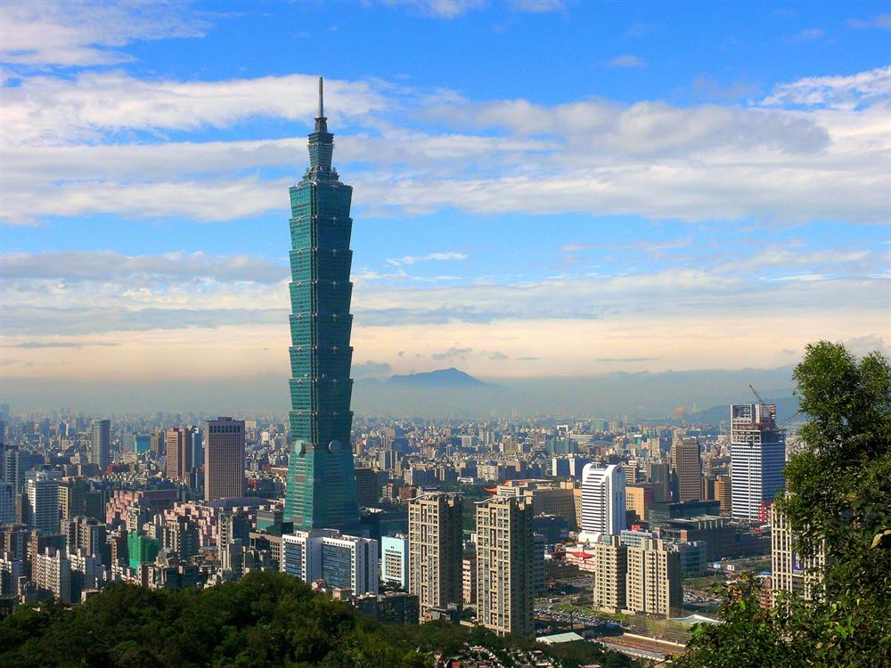
Home country(2)
Figure 1 and 2 are Taipei 101 Building

Slide 5
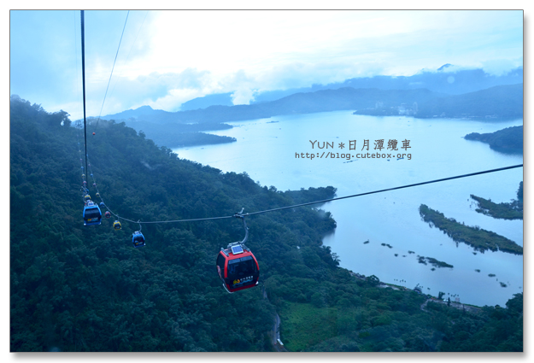
Home country(3)
Figure 3 and 4 are Sum Moon Lake

Slide 6
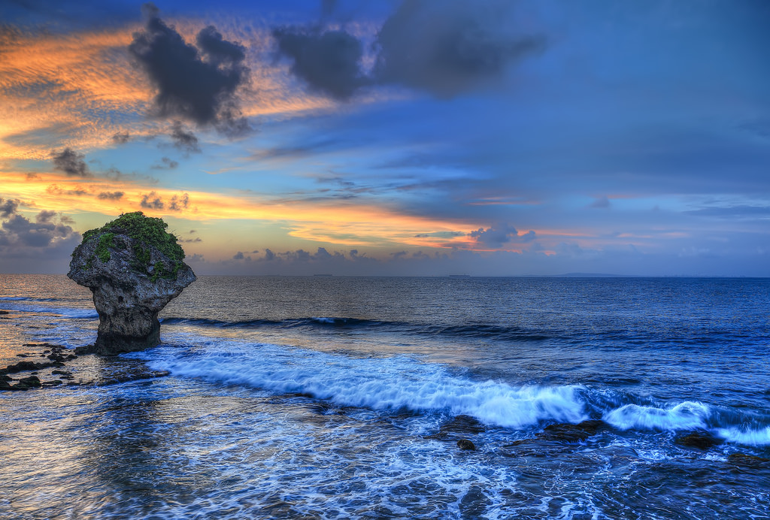
Home country(3)
Me
Figure 5 and 6 are LiuQiu Island

Slide 7
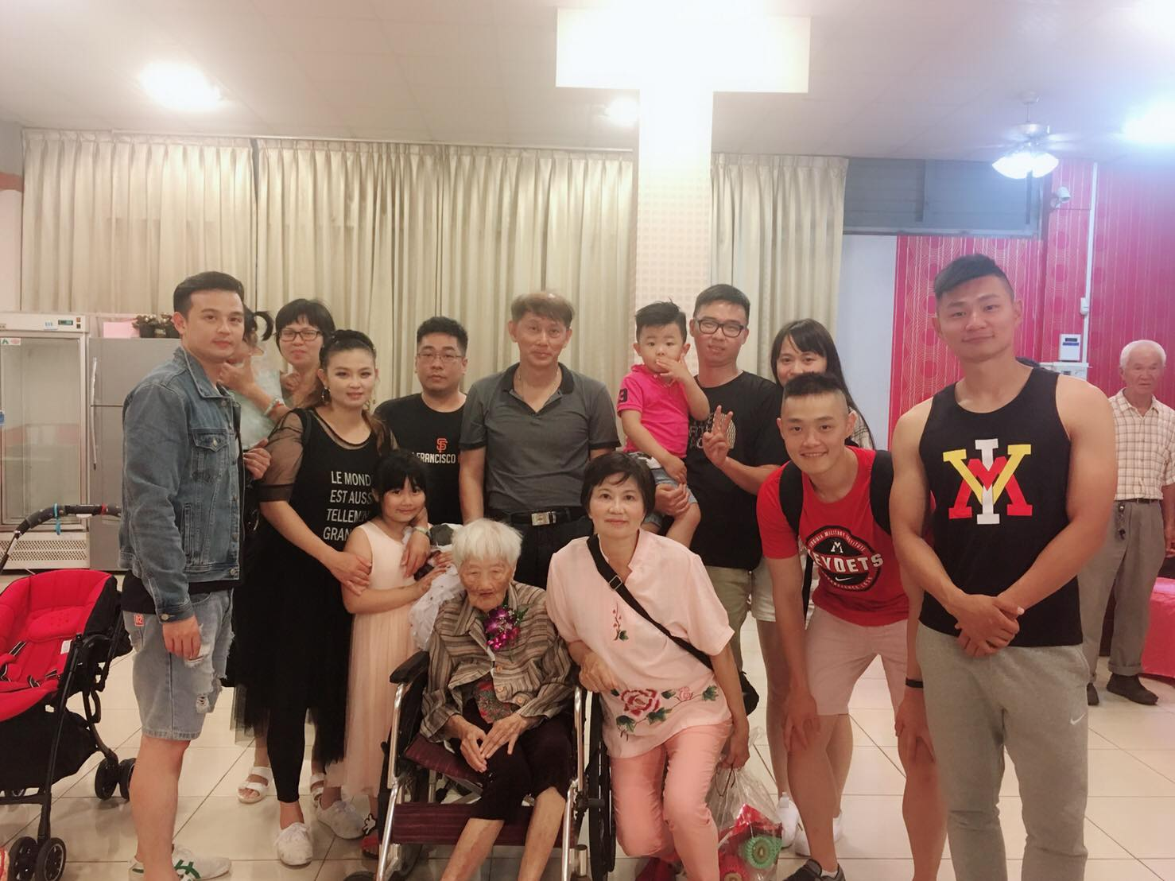
Family
Grandma & Graddad
Parents
2 elder sisters
1 elder brother
Uncles & Aunts
Cousins
Nephews

Slide 8
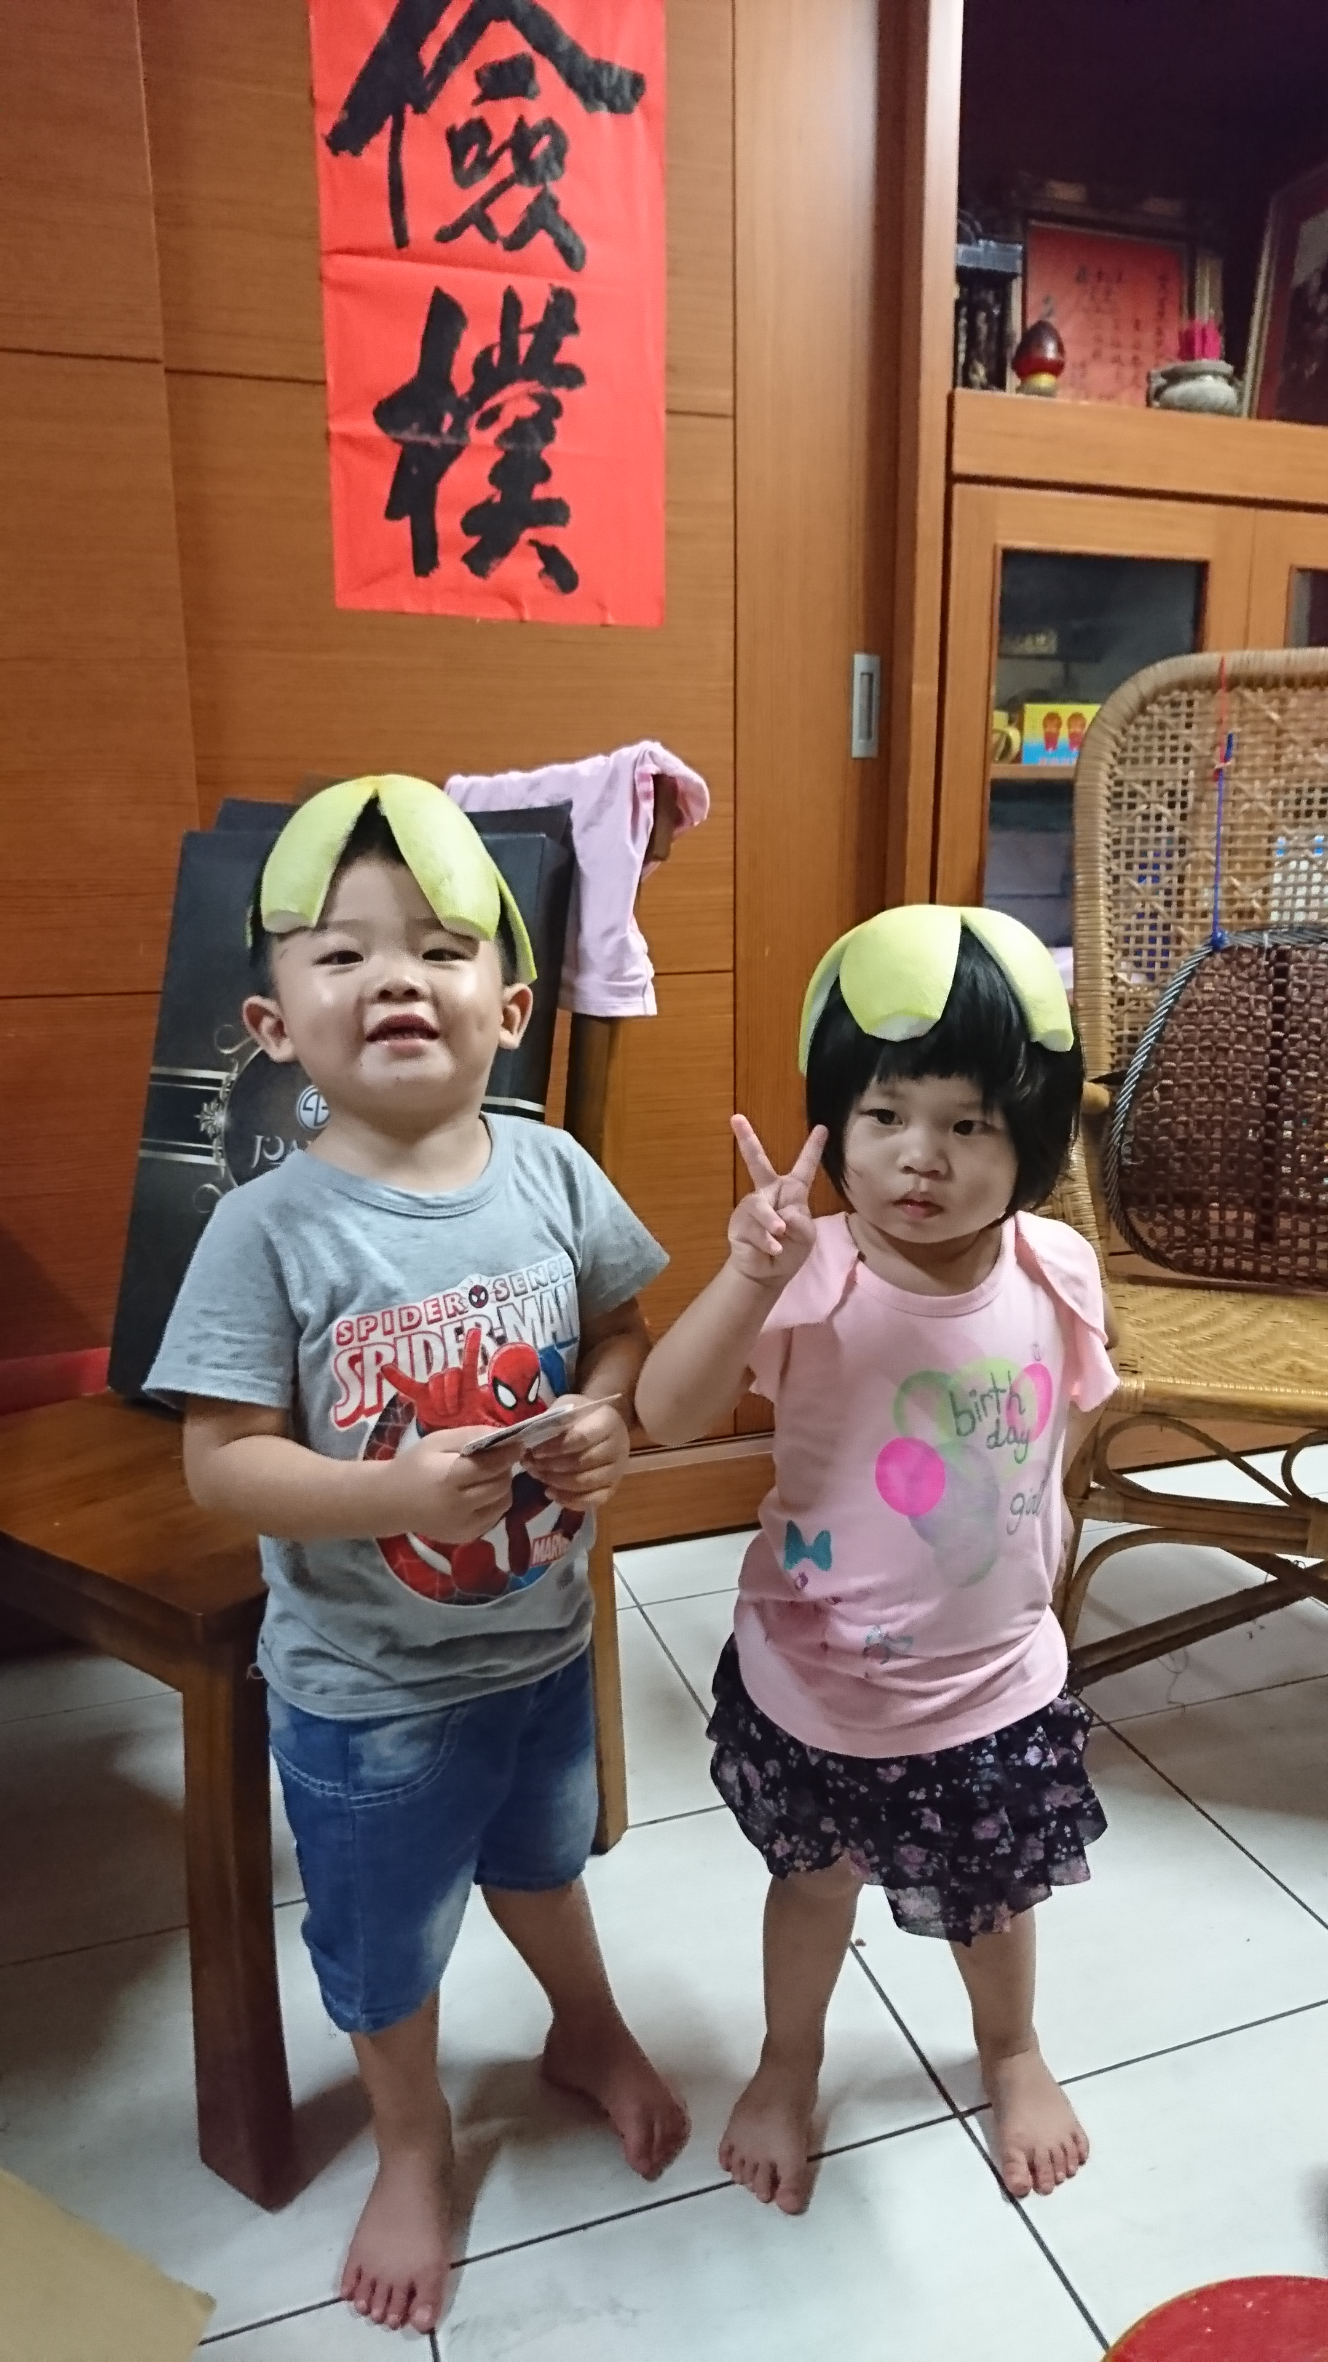
Family(2)

Slide 9
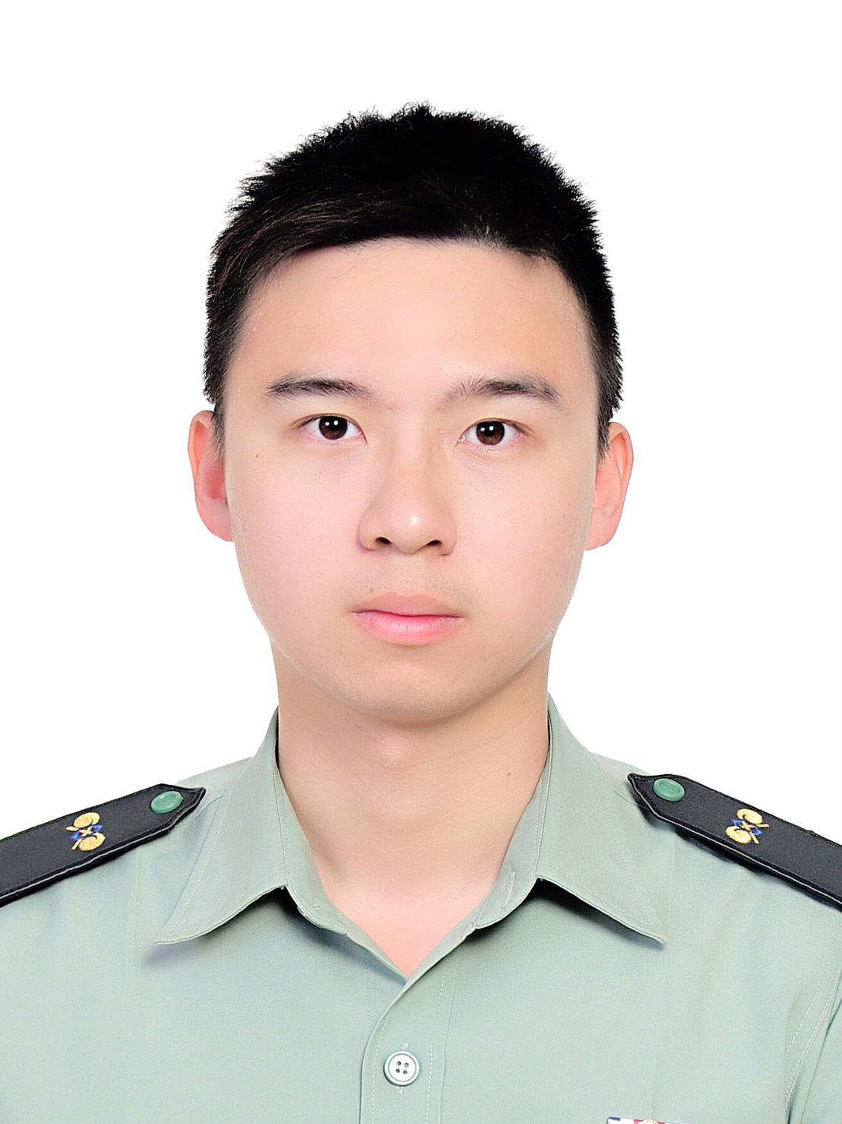
Military life
Used to be a military office
Captain
5 years experiences service in the military.
Eligible parachuter
Chemical technician
Platoon leader

Slide 10
Special experience
Yes, It’s me

Slide 11
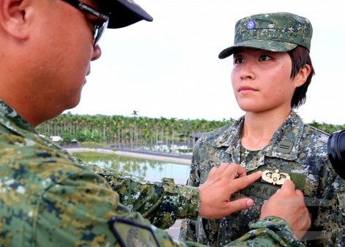
Parachute award

Slide 12
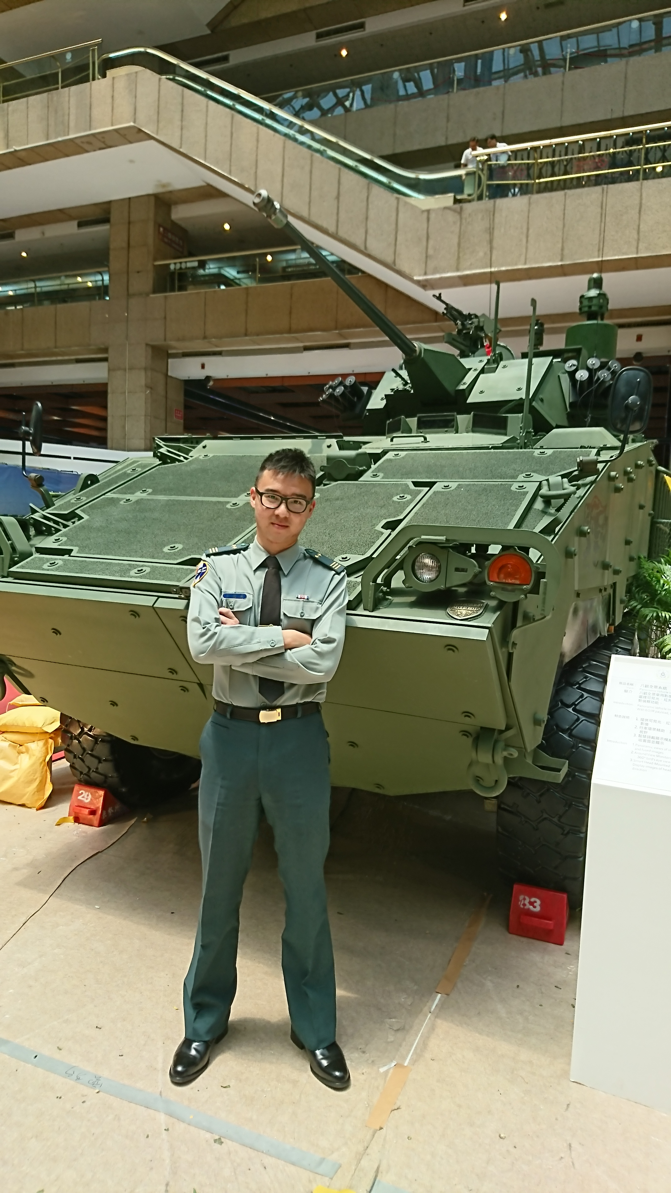
Work efforts
Me again!

Slide 13
Q&A

Slide 14
Thank you!

